Slide 1


ABO Blood group and Oral Cancer
Relation of ABO Blood groups with some oral diseases.
Nada Alshokre
Block: PTS
2904
**/**/20222

Slide 2
Objectives
Discuss the Risk factors of developing oral cancer.
Describe the relation between ABO Blood groups and oral cancer.
Discuss the genetic alteration of ABO Ag and oral cancer.

Slide 3


Slide 4
Risks factors of developing oral cancer
Tobacco
Alcohol
Smoking
Different expression of ABO Blood group

Slide 5

Blood group Ag Present on RBC cell membrane is also present on epithelial cells including oral mucosa.
H Ag present in all individuals of blood group types.
H Ag is converted to A and B Ag and it remain the same in O blood group.

Slide 6
Chi Square test
To evaluate the association between types of ABO Blood groups with oral cancer.
Analytical statistics

Slide 7
Analytic study
Analytic study was conducted in hospital of new Delhi in India at 2019.
Total 76 patient with oral cancer. ( Blood typing was done )
Control group of 90 blood donor.
( with no systemic illness , blood type were also recorded)

Slide 8
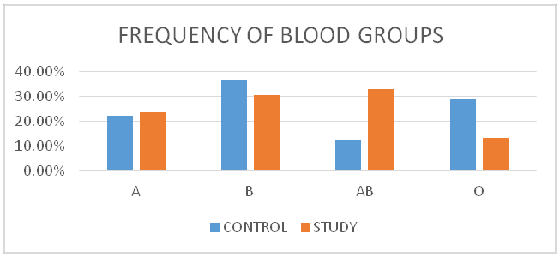

Slide 9
ABO Blood Ag are located on chromosome 9 which may get altered during malignancy.
Due to genetic changes of tumor the loss or presence of blood group Ag can increase cellular motility or facilitate the interaction between tumor cells and endothelial cells of distant organ.
Why Group AB ?

Slide 10
Some carcinomas in patients with A/B blood group may be due to their high affinity to certain microorganisms that may develop some malignancies.

Slide 11
This study show us the ABO blood groups that susceptible for oral cancer.
Hence regular cancer screening foe people with these susceptible blood groups should be advised.

Slide 12

Presence of A and B Antigens may increase the risk of oral cancer.
Blood group O has significantly lower frequency.
Patients with susceptible blood groups can be encouraged to quit tobacco smoking or pan chewing.

Slide 13
References
1.Jaleel BF, Nagarajappa R. Relationship between ABO blood groups and oral cancer. Indian J Dent Res. 2012;23(1):7-10. doi:10.4103/0970-9290.99029
2.Tandon P, Dadhich A, Saluja H, Bawane S, Sachdeva S. The prevalence of squamous cell carcinoma in different sites of oral cavity at our Rural Health Care Centre in Loni, Maharashtra - a retrospective 10-year study. Contemp Oncol (Pozn). 2017;21(2):178-183. doi:10.5114/wo.2017.68628

Slide 14


Slide 15
This high incidence of various carcinomas are found in patients having A/B blood groups may be due :

