Slide 1



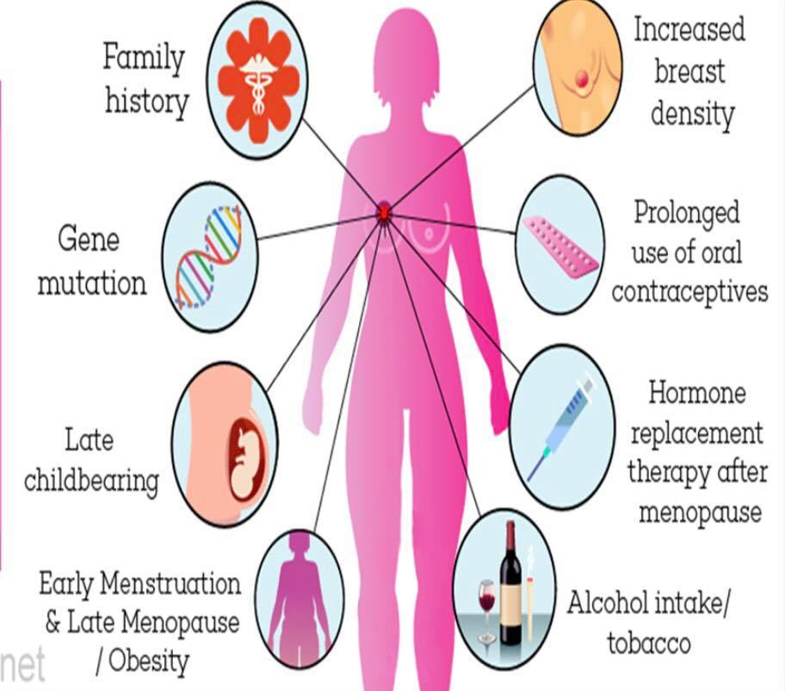
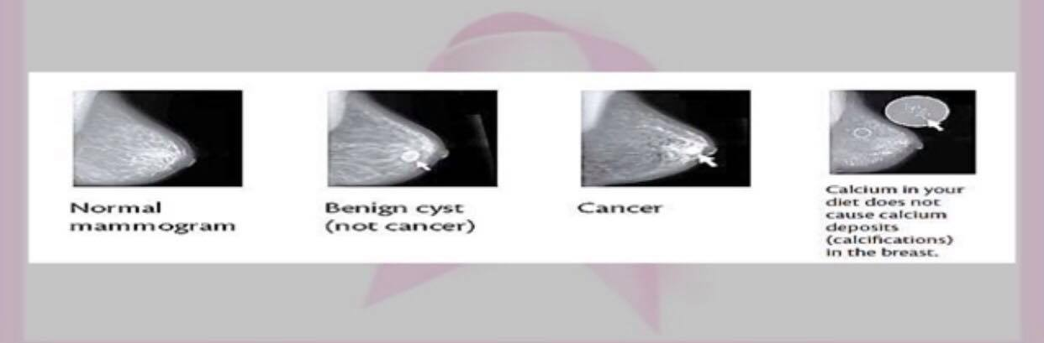
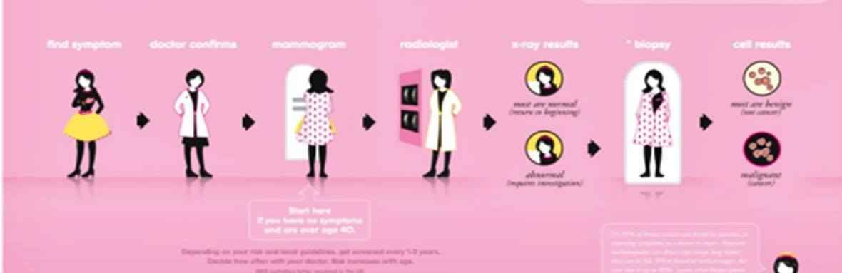
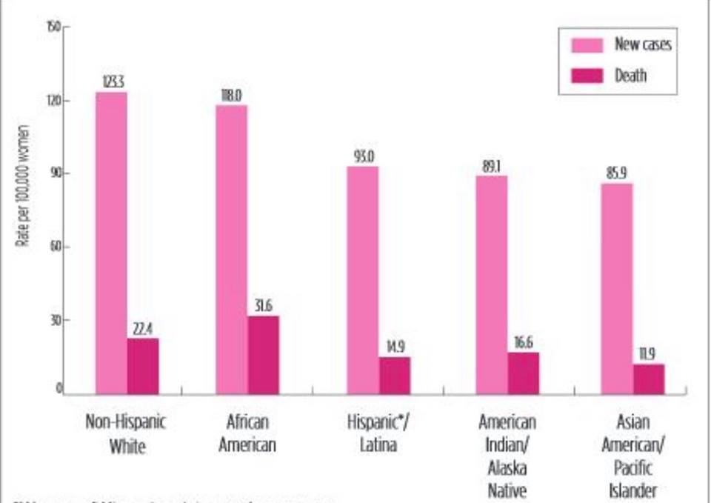
One in Eight
Breast Cancer Risk Factors And Screening Tests
Ayat Amer (1512) 4th Year Medical Student
Faculty Of Medicine , Libyan International Medical University
Introduction
Risk Factors
Screening Tests
.
Ages | Risk | Screening Tests and Frequency
Women < 50 | Average | Screening not recommended
Women 50–74 | Average | Mammography every 2 years
Women 50–74 | Higher than averageª | Annual mammography
Women 30–69 | High | Annual mammography and breast MRI, or screening breast ultrasound if MRI is contraindicated
What is the breast cancer ?
is the most common invasive cancer in women, In 2012, nearly 1.7 million new cases were diagnosed worldwide, making it the second most common cancer over all, It is also the most common cancer in women - the incidence rate among females is twice as much as that of colorectal cancer and cervical cancer and approximately three times that of lung cancer(1). Globally, the incidence of breast cancer is highest among American women16% of women between the age of 40-60 years have breast-related problems. Of these 40% complain of breast lumps (2).
Studies have shown that your risk for breast cancer is due to a combination of factors. Most women have some risk factors, but most women do not get breast cancer(3)
Breast cancer screening is the regular examination of healthy, asymptomatic women.Breast cancer is the most common cancer among Canadian women, with an estimated 1 in 8women expected to develop the disease during their lifetime.⁽¹⁾ In Ontario, an estimated 9,500 women are diagnosed with and 1,950 die from breast cancer annually,Screening can help find breast cancer early, when it is easier to treat
Table 1:Breast Screening Program Guidelines
Figure 4 : Mammogram image gallery
Conclusion
Figure 2: Common risk factors of breast cancer
Women considered at average risk for breast cancer generally have a less than 15% chance of developing the disease over a lifetime, whereas women considered at high risk generally have a genetic mutation or a greater than 25% (1 in 4) risk of developing the disease. Screening for BC is the process of looking for the disease before symptoms appear so it can be treated early
Risk Factors You Cannot Change :
Getting older.
Genetic mutations.
Reproductive history.
Family history of breast cancer.
Previous treatment using radiation therapy.
Women who took the drug diethylstilbestrol (DES).
Risk Factors You Can Change :
Not being physically active.
Taking hormones.
obesity.
alcohol intake / tobacco usage(4).
Figure3 : steps to detect breast cancer
Breast cancer detection :
Breast self examination BSE.
Clinical breast examination CBE.
Mammography.
Magnetic Resonance Imaging (MRI).
Ultrasonography(4).
high-risk populations, screening with both MRI and mammography annually improves the sensitivity of screening (sensitivity range 84–94%) but decreases specificity (specificity range 77–95%) relative to screening with mammography alone (5).
References
Figure 1: Rates of new cases (incidence) and death (mortality)from invasive breast cancer by race and ethnicity
1) Canadian Cancer Society's Advisory Committee on Cancer Statistics. Canadian cancer statistics 2015 [Internet]. Toronto (ON): Canadian Cancer Society; 2015. [cited 2015 Aug]. Available from: http://www.cancer.ca/statistics [Ref list]
(2) https://www.medindia.net/patientinfo/breast-cancer.htm#1
(3) Cancer Care Ontario. Ontario Breast Screening Program 2011 report. Toronto (ON): Cancer Care Ontario; 2013. [Ref list]
(4) https://www.medindia.net/patientinfo/breast-cancer.htm#1
(5) Cancer Care Ontario. About the Ontario Breast Screening Program [Internet]. Toronto (ON): Cancer Care Ontario; 2014. [cited 2015 May]. Available from: https://www.cancercare.on.ca/pcs/screening/breastscreening/obsp/[Ref list]

