Slide 1



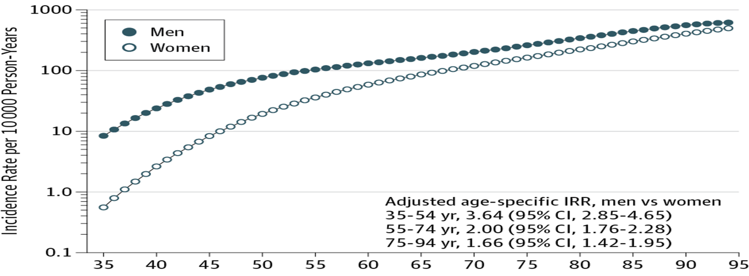

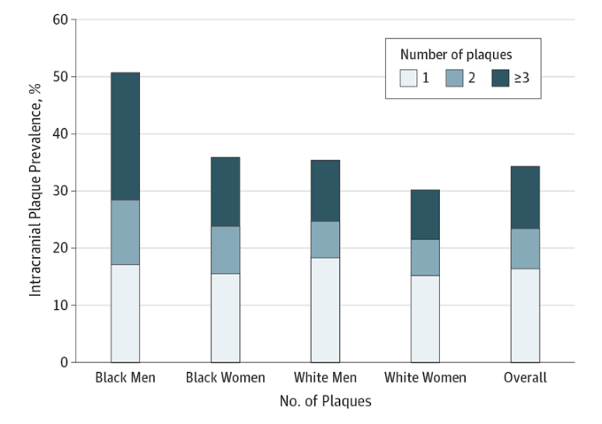
No man's land! Why do Men Die Younger than Women?
Hibba Hassan Ali
3rd Year of Basic Medical Science
Libyan International Medical University
Introduction
Figure 1. Incidence of myocardial infarction in both genders.
Discussion
Men have shorter life expectancies than women in most nations around the world. Gender is an important factor determining the source of health information used. Women are more likely to seek advice from peers, magazines, books, and the television than men. There are also differences in how men from different socioeconomic groups access and respond to information.⁽¹⁾ United States research shows that men with health problems are more likely than women to have had no recent contact with a doctor regardless of income or ethnicity. This reluctance means that men often do not seek help until a disease has progressed or lack of awareness may also contribute to late diagnosis and can have serious consequences. The effects of heart disease, the greatest cause of early male death. The incidence of these disease could also be reduced by better knowledge of risk factors such as male obesity. Here the question is how would we equal the gender gap in mortality.⁽²⁾
Women’s advantaged mortality can be classified into three categories:
1. Biological standpoint, it appears that estrogen helps protect women against heart disease by reducing circulatory levels of harmful cholesterol, whereas testosterone increases low-density lipoprotein. Further, women have stronger immune systems, in part because testosterone causes immunosuppression.⁽²⁾ The Y chromosome tends to develop developmental disorders are also more common among boys; some of these could shorten life expectancy.⁽³⁾
2. Social and economic status of women relative to men has been rising in industrialized nations for some time, and women's health has benefited from these improvements. It appears that the gender gap in life expectancy would be even bigger if women were more economically equal to men.⁽¹⁾⁽²⁾
3. Behaviours make an important contribution to male disadvantage in mortality. Adult women under the age of 65 report more doctor visits than men. In addition, men drink alcohol more, and more often, than women and are more than twice as likely to die from chronic liver disease and cirrhosis. Men are also two to four times more likely than women to die prematurely from unintentional injury, homicide, and suicide.⁽¹⁾⁽²⁾
Figure 2. image illustrating arthrosclerosis
Method
The first study examines the overview of mortality gap between both gender, primarily in the United States from 1975 to 2003.⁽²⁾ The second study compared incidence of myocardial infarction between both genders during 1979 through 2012 in Norway. Dates of diagnoses were assessed retrospectively by linking to information from the local hospital discharge register and the nation cause of death registry.⁽⁴⁾ Lastly, the third study was performed comparing the gender differences in Intracranial atherosclerotic disease in the United States between 2011 till 2015. The prevalence of Intracranial atherosclerotic disease was estimated in the overall population.⁽⁵⁾
Conclusion
Men had more risk factors and a higher incidence of death as compared to women, remaining an important issue. Better medical education and health services such as NHS Direct Online should be provided and advised internationally so that the mortality gap between both sexes can decrease and we can confidently say that our land is no longer a “no man's land”.
Results
Figure 3. Incidence of intracranial atherosclerotic disease in both genders.
References
In the first study, the average for women was 57% by age 65 and 67% by age 85, meaning, the lifespan is about 5 years longer for women than men in the United States.⁽²⁾ In the second study, the total of 2793 persons, 886 women and 1907 men, received a diagnosis of incident myocardial infarction during follow-up at ages 35 to 102 years in the period 1979 through 2012 . The adjusted risk curves were close to parallel, before age 45 to 50 years and after age 70 years, but the distance between the curves was considerably smaller among the oldest (fig. 1).⁽⁴⁾ Lastly, the third study observed 1752 patients diagnosed with intracranial atherosclerotic disease, in which 53% men and 47% women. Black men also had the highest frequency of multiple plaques (22.4% of black men had >3 plaques vs 12.1% for black women, 10.7% for white men, and 8.7% for white women (fig. 3).⁽⁵⁾
Banks I. No mans land: men, illness, and the NHS. Bmj. 2007;323(7320):1058-1060. doi:10.1136/bmj.323.7320.1058.
Medscape Log In. https://www.medscape.com/viewarticle/555221_2.
Shmerling RH. Why men often die earlier than women. Harvard Health Blog. https://www.health.harvard.edu/blog/why-men-often-die-earlier-than-women-201602199137. Published February 19, 2016.
Albrektsen G. Gender Gap in Risk of Incident Myocardial Infarction. JAMA.https://jamanetwork.com/journals/jamainternalmedicine/fullarticle/2548254?resultClick=1. Published November 1, 2016.
Qiao Y. Racial Differences in Prevalence of and Risk for Intracranial Atherosclerosis. JAMA. https://jamanetwork.com/journals/jamacardiology/fullarticle/2660060?resultClick=3. Published December 1, 2017.

