Slide 1


Marketing information system
Libyan International Medical University
Faculty of Business Administration
Name: Jude Boughalia 3766
Email: joud_3766@limu.edu.ly

Slide 2
Table of contents
01
02
03
04
05
06
introduction
definition
components
example
conclusion
reflection
02

Slide 3
Introduction
The marketing information system provides useful data to marketers so that they can make critical choices about pricing, packaging, product design, sales, media, and advertising, among other things.
03

Slide 4
Definition
A marketing information system (MIS) is a system for gathering, saving, evaluating, and sharing critical marketing information from several different sources.
04

Slide 5
components
Internal records
Marketing intelligence system
Marketing research
Marketing decision support system
05

Slide 6
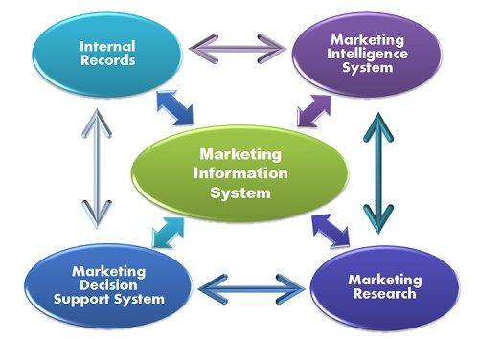
06

Slide 7
example
Many stores offer loyalty cards to their customers, and many companies allow users to create profiles in their online shops. Both loyalty cards and profiles benefit companies in collecting information about their customers.
07

Slide 8
conclusion
If you're a marketer or a business owner, you'll need to make effective decisions to improve your product, improve your customer base, attract new customers, and deal with competitors. The most reliable foundation of any decision is data.
08

Slide 9
reflection
It’s important to collect data about your clients to make important decisions. such as, developing your product, packaging, pricing, and advertising, etc.
09

Slide 10
references
Says, S. S., Sharma, S., says, A. A., Alandis, A., Says, V., Vincent, says, O. B. I. N. B. E. N. A. R. D. E. R. I. Y. A., Eriya, O. B., says, F. W., Wu, F., Says, P., Priya, Says, K. Y., Ye', K., says, I., Ivan, says, R. E. G. I. N. A., Regina, says, A. S., … Tabassum. (2016, June 13). What is marketing information system? definition and meaning. Business Jargons. Retrieved May 10, 2022, from https://businessjargons.com/marketing-information-system.html
Home. SendPulse. (2022, February 16). Retrieved May 11, 2022, from https://sendpulse.com/support/glossary/marketing-information-system
10

Slide 11
THANK YOU!

