Slide 1


Non-Verbal Communication Competence
Libyan International Medical University Faculty of Business Administration
Abdulhamid Elborki
2858
Abdulhamid_2858@limu.com

Slide 2
Contents
Introduction
The important of non-verbal communication
Types of non-verbal communication
Conclusion
References

Slide 3
Introduction
Non-verbal communication is the transfer of information through the use of body language including eye contact.

Slide 4
The important of non-verbal communication
It supports your message
It communicates messages.
It conveys feelings.
It offers support.

Slide 5
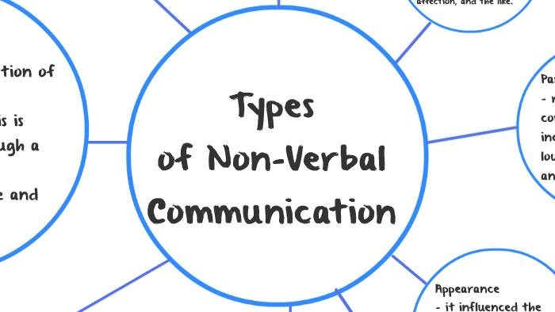
Types of non-verbal communication

Slide 6

Body language
Body language is the way someone situates their body depending on the situation, the environment and how they are feeling

Slide 7
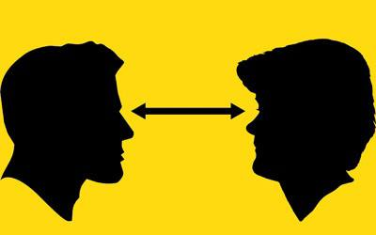
Eye contact
Strategically using eye content (or lack of eye contact) is an extremely effective way to communicate your attention and interest

Slide 8
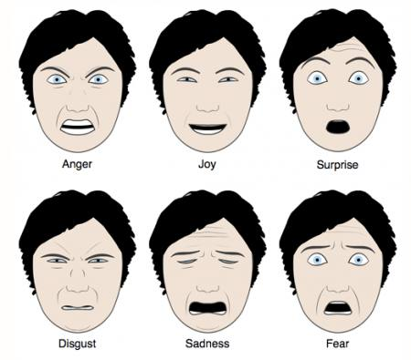
Facial expressions
One of the most common forms of nonverbal communication is facial expressions. Using the eyebrows, mouth, eyes and facial muscles to convey emotion or information can be very effective.

Slide 9
Conclusion
We can use body language in our advantage by knowing how we should use it as well as know what messages others are sending when using

Slide 10


Slide 11
References
Meadors, J. D., & Murray, C. B. (2014). Measuring Nonverbal Bias Through Body Language Responses to Stereotypes. Journal of Nonverbal Behavior, 38(2), 209–229. https://doi.org/10.1007/s10919-013-0172-y
Watkins, H. (1998). Information skills training. Librarian Career Development, 6(6). https://doi.org/10.1108/lcd.1998.10206fab.006

Slide 12


