Slide 1


The Misuses of Power and Their Influence
Libyan International Medical University
Faculty of Business Administration
Name: Jude Boughalia
ID: 3766
Email: joud_3766@limu.edu.ly

Slide 2
01
02
03
TABLE OF CONTENTS
Objectives
Introduction
Definition of Harassment, Bullying, and Power Play
04
The Influence of The Misuses of Power
05
Conclusion
06
Reflection
07
References
02

Slide 3
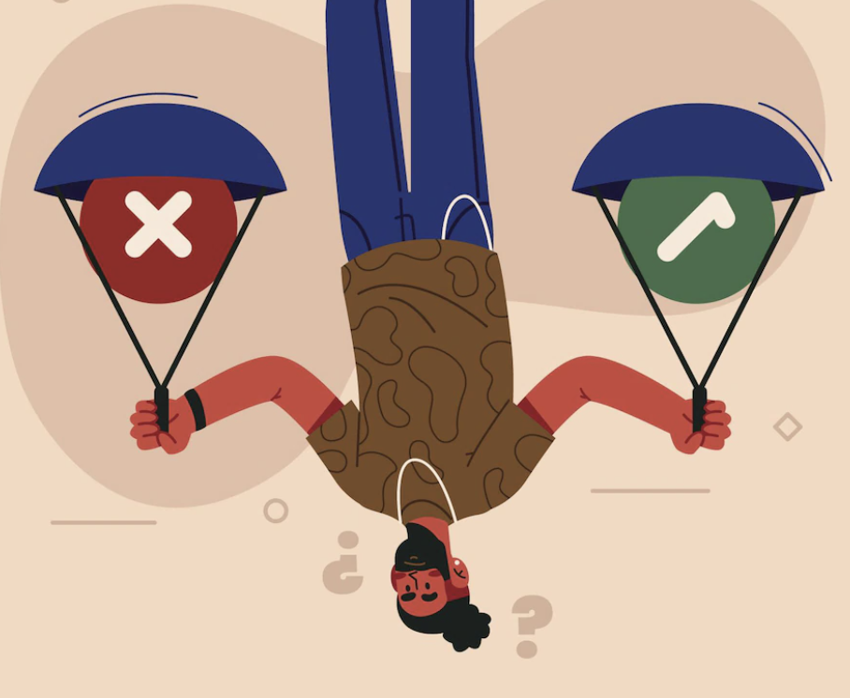
Learning Objectives
01
By the end of this presentation you’ll be able to:
Define Harassment, Bullying, and Power Play
02
Identify The Influence of The Misuses of Power
03

Slide 4
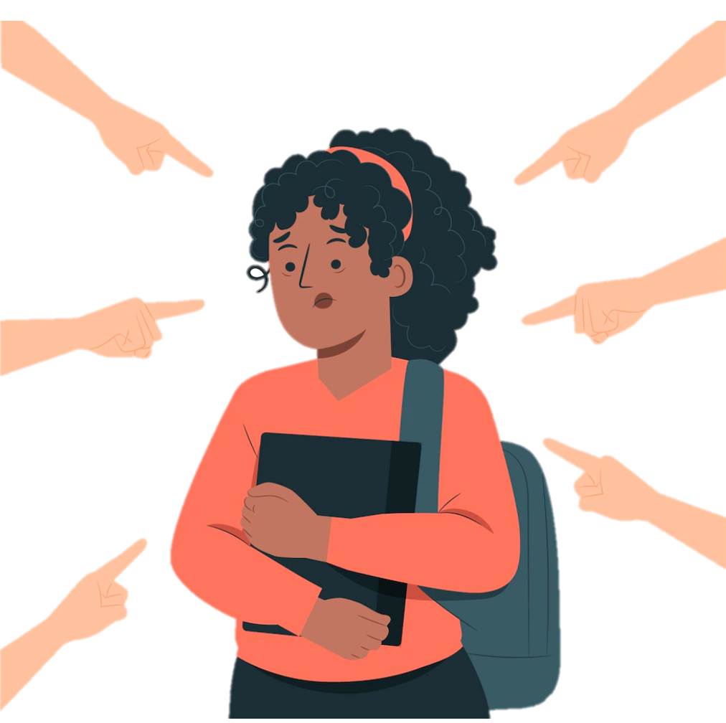
Introduction
Misuse of power, also known as power harassment, is the use of authority for personal gain at the expense of the company and its employees. It is a type of workplace bullying that is committed by a manager.
04

Slide 5
Definition of Harassment
Inappropriate behavior toward a person that causes mental or emotional discomfort, such as continuous unwanted interactions without a reasonable purpose, insults, threats, touching, or abusive language.
Examples of harassment in the workplace include highly offensive jokes, racial slurs, personal insults, and expressions of disgust toward a particular person.
05

Slide 6
Definition of Bullying
Bullying is the repetitive verbal, physical, and/or social abuse of power in relationships with the intention of causing physical, social, and/or psychological harm.
Bullying can also include insulting employees or coworkers, making threats, taking credit for the achievements of others, or stealing work equipment.
06

Slide 7
Definition of Power Play
A power play is an attempt to gain an advantage by showing your dominance over another person or group.
The power play happens when someone acts as the leader, correcting your work, or even reporting your mistakes to management.
07

Slide 8

The Influence of The Misuses of Power (Harassment, Bullying, and Power Play)
Misuse of power can harm employee satisfaction, decrease productivity, increase employee turnover rate, cause stress-related disorders, and harm the company's brand. These circumstances frequently occur when victims believe they have no one to turn to.
08

Slide 9
Conclusion
09

Slide 10
Conclusion
The misuse of power refers to the use of one's position of power to harm others, to bully or humiliate them, or to gain personal advantages for themselves or their friends.
10

Slide 11
Reflection
11

Slide 12

Reflection
Although it would be lovely to believe that power is typically used for the benefit of all, power is often used selfishly and unfairly. Therefore, protecting, and acting on equal principles and concepts is the most effective strategy to prevent abuse of power.
12

Slide 13
References
13

Slide 14
DEVITO, J. O. S. E. P. H. A. (2022). Interpersonal communication book. PRENTICE HALL.
Contributor, C. (2020, November 13). How to reduce the misuse of power in a workplace. Small Business - Chron.com. Retrieved January 3, 2023, from https://smallbusiness.chron.com/reduce-misuse-power-workplace-43541.html
Lucy. (2020, August 25). The power plays at work and how to spot them and what to do about them. 3WH. Retrieved January 3, 2023, from https://www.3wh.uk.com/the-power-plays-at-work-and-how-to-spot-them-and-what-to-do-about-them/
How can abuse of power be prevented? Egalitarianism. (n.d.). Retrieved January 4, 2023, from https://www.pdrboston.org/how-can-abuse-of-power-be-prevented
REFERENCES
14

Slide 15
THANK YOU

