Slide 1

EFFECT OF HEPATITIs B VIRUS ON HUMAN BODY
Libyan International Medical University
Faculty of Applied Medical Science
Student Name: Mohamed El-Hasia
Student ID: 3043
Supervised By: Dr. Raghda Kashbor
Date: 2022/03/22

Slide 2
OBJECTIVES :
Define Hepatitis B Virus
Discuss the Management of Hepatitis B virus
Discuss epidemiology and Transmission of Hepatitis B virus
Discuss prevention of Hepatitis B virus
Discuss the effect of Hepatitis B virus on pregnancy
List the Symptoms of Hepatitis B virus
02.

Slide 3
Introduction
Hepatitis B is a vaccine-preventable liver infection caused by the hepatitis B virus (HBV).
Hepatitis B is spread when blood, semen, or other body fluids from a person infected with the virus enters the body of someone who is not infected.
03.

Slide 4
Define Hepatitis B Virus
04.

Slide 5
Definition of Hepatitis B Virus
Hepatitis B is an infection of your liver. It’s caused by a virus.
There is a vaccine that protects against it. For some people, hepatitis B is mild and lasts a short time.
These “acute” cases don’t always need treatment. But it can become chronic
05.

Slide 6
Epidemiology and Transmission of Hepatitis B virus
06.

Slide 7
Epidemiology of Hepatitis B virus
Hepatitis B is found worldwide but is particularly prevalent in Asia.
Globally, more than 300 million people are chronically infected with HBV, and about 75% of them are Asian.
There is a high incidence of hepatocellular carcinoma (hepatoma) in many Asian countries.
07.

Slide 8
Global: 296 Million people infected
Source: World Health Organization (2021). Global Progress Report 2021: HV, viral hepatitis and sexually transmitted infections. Overview of the Global Health Sector Strategies, past and future.
08.

Slide 9
Transmission of Hepatitis B virus
The three main modes of transmission are via blood, during sexual intercourse, and perinatally from mother to newborn.
The observation that needle-stick injuries can transmit the virus indicates that only very small amounts of blood are necessary.
09.

Slide 10
effect of hepatitis b virus on pregnancy
10.

Slide 11
Effect of hepatitis b on pregnancy
If you’re pregnant, you might pass the virus to your baby at birth. It’s less likely to happen during your pregnancy.
If your baby gets the virus and isn’t treated, they could have long-term liver problems.
All newborns with infected mothers should get the vaccine for hepatitis at birth and during their first year of life.
11.

Slide 12
symptoms of hepatitis B virus
12.

Slide 13
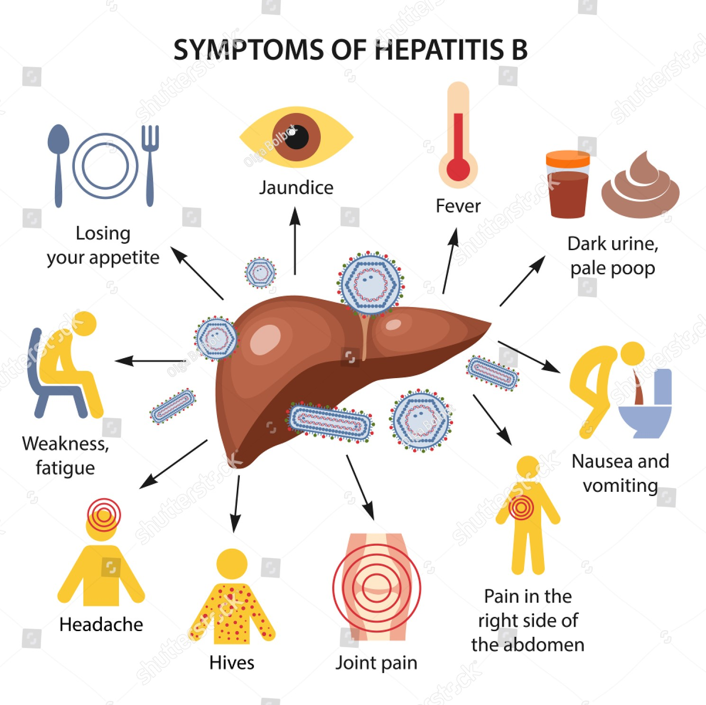
https://www.shutterstock.com/image-vector/hepatitis-liver-symptoms-b-form-color-1431434639
13.

Slide 14
management of Hepatitis B virus
14.

Slide 15
Management of hepatitis b virus
There is no specific treatment for acute hepatitis B. Therefore, care is aimed at maintaining comfort and adequate nutritional balance, including replacement of fluids lost from vomiting and diarrhea.
Chronic hepatitis B infection can be treated with medicines, including oral antiviral agents (tenofovir or entecavir).
15.

Slide 16
Prevention of hepatitis b virus
16.

Slide 17
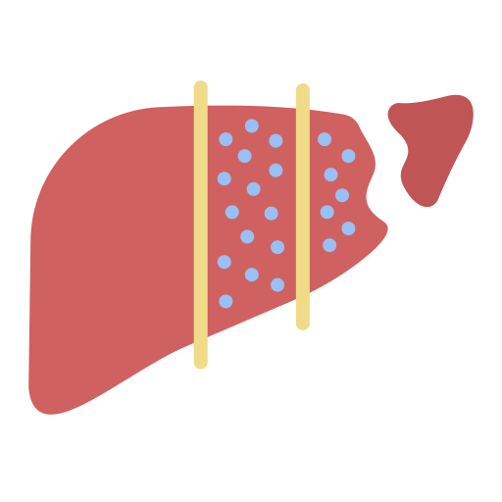
Use Sterile Syringes
Cover all open cuts or wounds
Use protection during sexual Intercourse
Don’t share personal tools
Follow the rules of personal Hygiene
Vaccination
17.

Slide 18
conclusion
HBV is a leading cause of death worldwide and the primary cause of hepatic cirrhosis and HCC. Chronic HBV infection is an increasingly important public health problem.
Preventing Hepatitis B infection averts the development of complications including chronic disease and liver cancer
18.

Slide 19
References
Levinson, Warren. Review of medical microbiology and immunology. 14rd ed. The McGraw-Hill Companies, 2016. https://www.webmd.com/hepatitis/digestive-diseases-hepatitis-b.
https://www.who.int/news-room/fact-sheets/detail/hepatitis-b.
Centers for Disease Control and Prevention. 2022. Hepatitis B. [online] Available at: <https://www.cdc.gov/hepatitis/hbv/index.htm> [Accessed 21 March 2022].
19.

Slide 20
THANK you for your attention !
Any
Questions?

