Slide 1


MALNUTRATION & STUNTING
Name: Mohammed salah
Number: 3080
Block: PTS
Date:15/5/2022

Slide 2
Objectives
01.
02.
03.
04.
Stunting
Malnutrition & stunting
Define stunting & causes
Relation between malnutrition and stunting
Vicious cycle of stunting
Prevention of stunting
How stunting can countinue through generations
How stunting can be prevented

Slide 3
Introduction
Malnutrition in all its forms includes undernutrition (wasting, stunting, and
underweight), vitamin or mineral deficiencies, overweight, obesity, and diet-
related noncommunicable diseases. 1.9 billion people are overweight or
obese
while 462 million people are underweight. 52 million children under
the age of five are wasted, 155 million are stunted

Slide 4
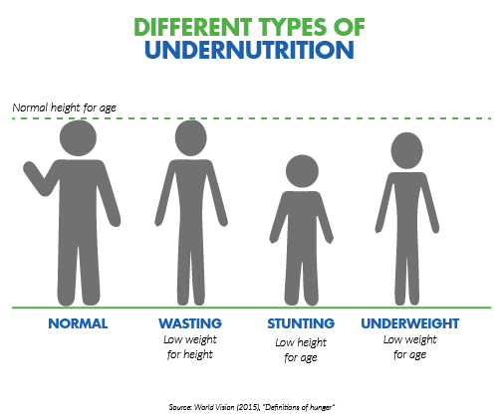
Definition stunting
Stunting is when a child has a low hight for their age usually due to malnutrition, repeated infections, and/or poor social stimulation.
Notes:
It’s important to note that stunting is different from wasting. If stunting is a low height for a child’s weight, wasting is low weight for a child’s height.

Slide 5
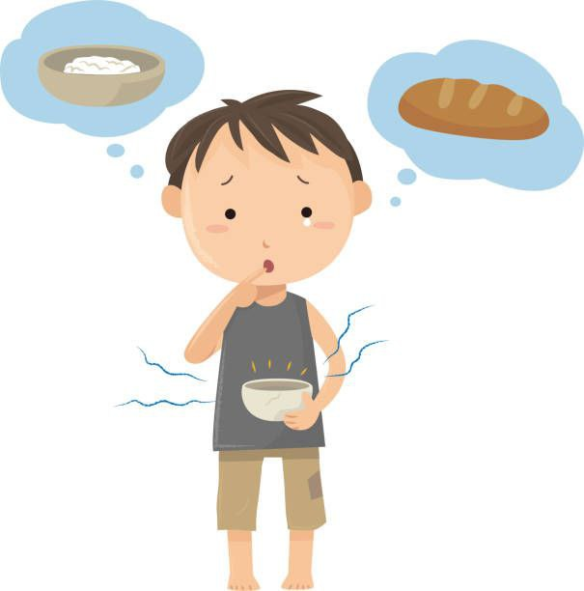
Causes of stunting
Poor nutrition and a lack of access to diverse foods
Poor sanitation and no access to clean drinking water
Lack of proper healthcare for children and their mothers
Inadequate psychosocial stimulation and/or parent-infant bonding
Notes:
There are many factors that contribute to childhood stunting, and these factors are often linked. Some common factors linked to stunting include:

Slide 6
Malnutrition & stunting
A balanced diet
A gap in intake of macro and micro nutrients can put a child into the cycle that takes its toll on growth. This cycle starts with inadequate nutrition and it may lead to infection & impaired immunity.
Notes:
A balanced diet must contain sufficient amount of carbohydrate, protein, fat, vitamins, minerals and fibre in the required amounts. Each of these nutrients has a vital role in the all-round growth and development of children.

Slide 7
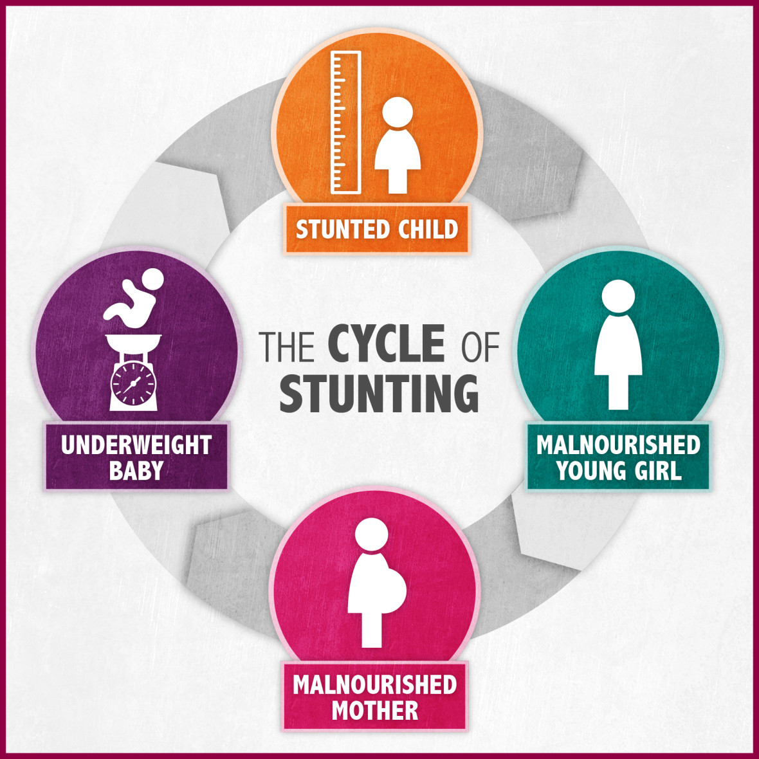
Vicious cycle of stunting
Notes:
After a child is born, it’s important for both mother and baby receive proper postnatal care. For babies born into poverty, one of the most important weapons to combat stunting is breastmilk, which strengthens their immune system and provides the nutrients they need to grow.
If a mother is malnourished, it’s more likely that her baby will be born underweight. This sets off a cycle of stunting: Without proper postnatal care and the proper nutrients, the baby will likely suffer from stunted growth. If the child’s malnutrition goes untreated, they themselves may grow into a young woman who becomes a malnourished mother to a stunted child.

Slide 8

Prevention of stunting
focusing on what is
commonly referred to
As the first 1,000 days.
the window of time between a
mother’s pregnancy and her
child’s second birthday is a key
opportunity to ensure the healthy
development of children around the
world.
Notes:
is a key opportunity to ensure the healthy development of children around the world.
While the amount of food is a large piece of the puzzle, a diversified diet can be equally, if not more, important. Treating malnutrition, even in those children who are older than 2, with ready-to-use therapeutic food (RUTF) can have a positive impact on stunting rates.

Slide 9
Conclusion
Malnutrition is one of the biggest global health problems, especially in our continent of Africa
This malnutrition can cause stunts in growth and leads to weaker adults both physically and in terms of intelligence.
We have to try our best to eradicate this problem especially in our neighbouring countries.
We must all raise awareness for this problem and try to donate to international organisations like UNICEF.

Slide 10
References
Concern Worldwide. 2019. Stunting: What it is and what it means. [online] Available at: https://www.concernusa.org/story/what-is-stunting/
Pediasure IN. 2020. Child Growth and Development | Child Health Nutrition. [online] Available at: https://pediasure.in/child-nutrition/child-growth-and-development#:~:text=Adequate%20nutrition%20is%20one%20of,and%20development%20of%20children1.
Who.int. 2021. Malnutrition. [online] Available at: https://www.who.int/health-topics/malnutrition
UNICEF DATA. 2018. Malnutrition in Children - UNICEF DATA. [online] Available at: https://data.unicef.org/topic/nutrition/malnutrition/

Slide 11
Thanks for listening

