Slide 1



Learning The Meaning of The Word Concept
By Ghadi Dreza
ID Nom-2830
Email- ghudai_2830@limu.edu.ly
3rd December 2020

Slide 2
Contents
What is a concept?
What is cognition?
What are the three hierarchal model of concept classification?
Conclusion.
Reference.

Slide 3


What is a Concept?
A concept is an abstract idea, a term mostly used for a notion that occurs mostly in the mind, in speeches, or in thoughts. Often, concept is regarding as the foundation of the building blocks of thoughts, beliefs, and ideas.
Examples, things like; intangible (untouchable or non-physical), theory, universe, time!!!

Slide 4
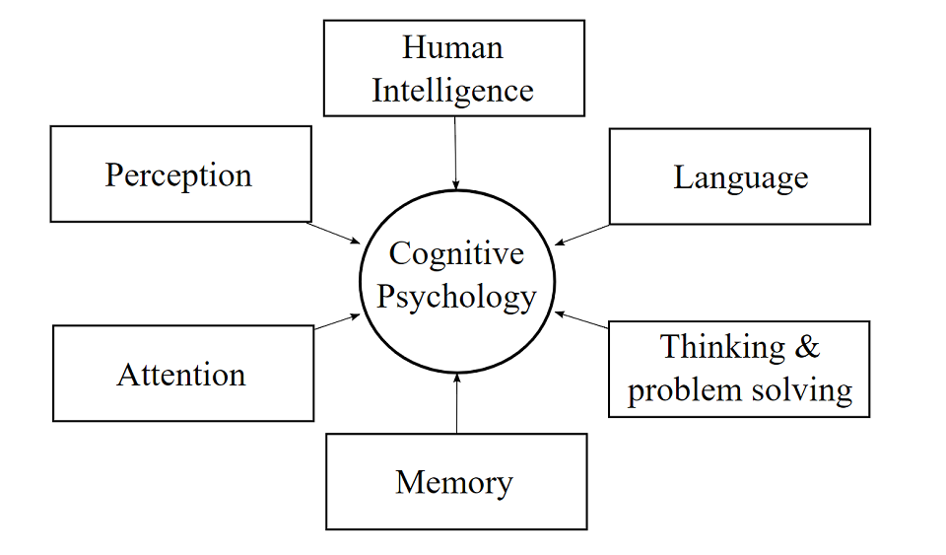
What is Cognition?
Cognition is a term used to refer to the mechanical processes of the mind. Additionally, it is also used to gaining the knowledge and understanding through; thinking, knowing, and problem-solving etc.

Slide 5
What are the three hierarchal model of concept classification?
Subordinate: it’s a subdivion for the basic-concept category, because its even more specific. For example, sports car.
Basic (more specific): they are the things that depict time, location, feeling, description, even an animal.
Superordinate (less specific): they are the most general way to classify something .e.g. dog… it is at the base of the hierarchy.
Hierarchy- Pyramid Example
Subordinate
Basic
Superordinate

Slide 6
Conclusion
A concept, if you may know, plays an important role in every individuals life. It is the architect of our thoughts, our beliefs; even the way we choose to see the world around us and simply think of it, a concept plays a role in that.

Slide 7
References
https://en.wikipedia.org/wiki/Concept Concept, Wikipedia, November 22nd 2020.
Retrieved from:
https://study.com/academy/lesson/types-of-concepts-superordinate-subordinate-and-basic.html Study.com.

Slide 8
THANK YOU, FOR LISTENING!

