Slide 1
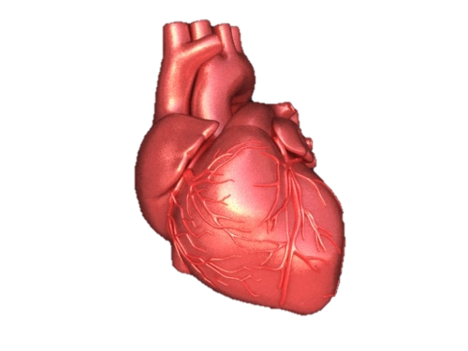
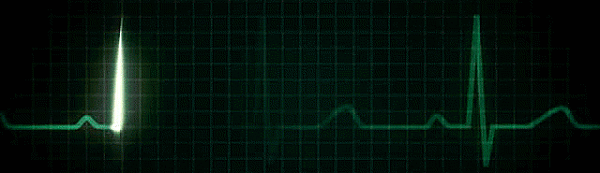
ARRYTHEMIA
Dr. Zaki Bettamer
Zikoecho @yahoo.com

Slide 2
Reading normal ECG

Slide 3
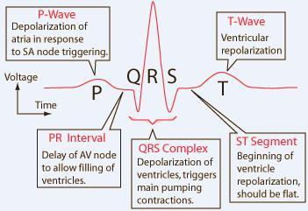
Anatomy of Heart and ECG signal

Slide 4
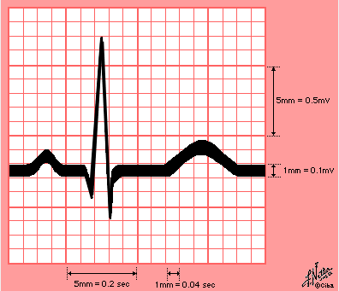

Slide 5
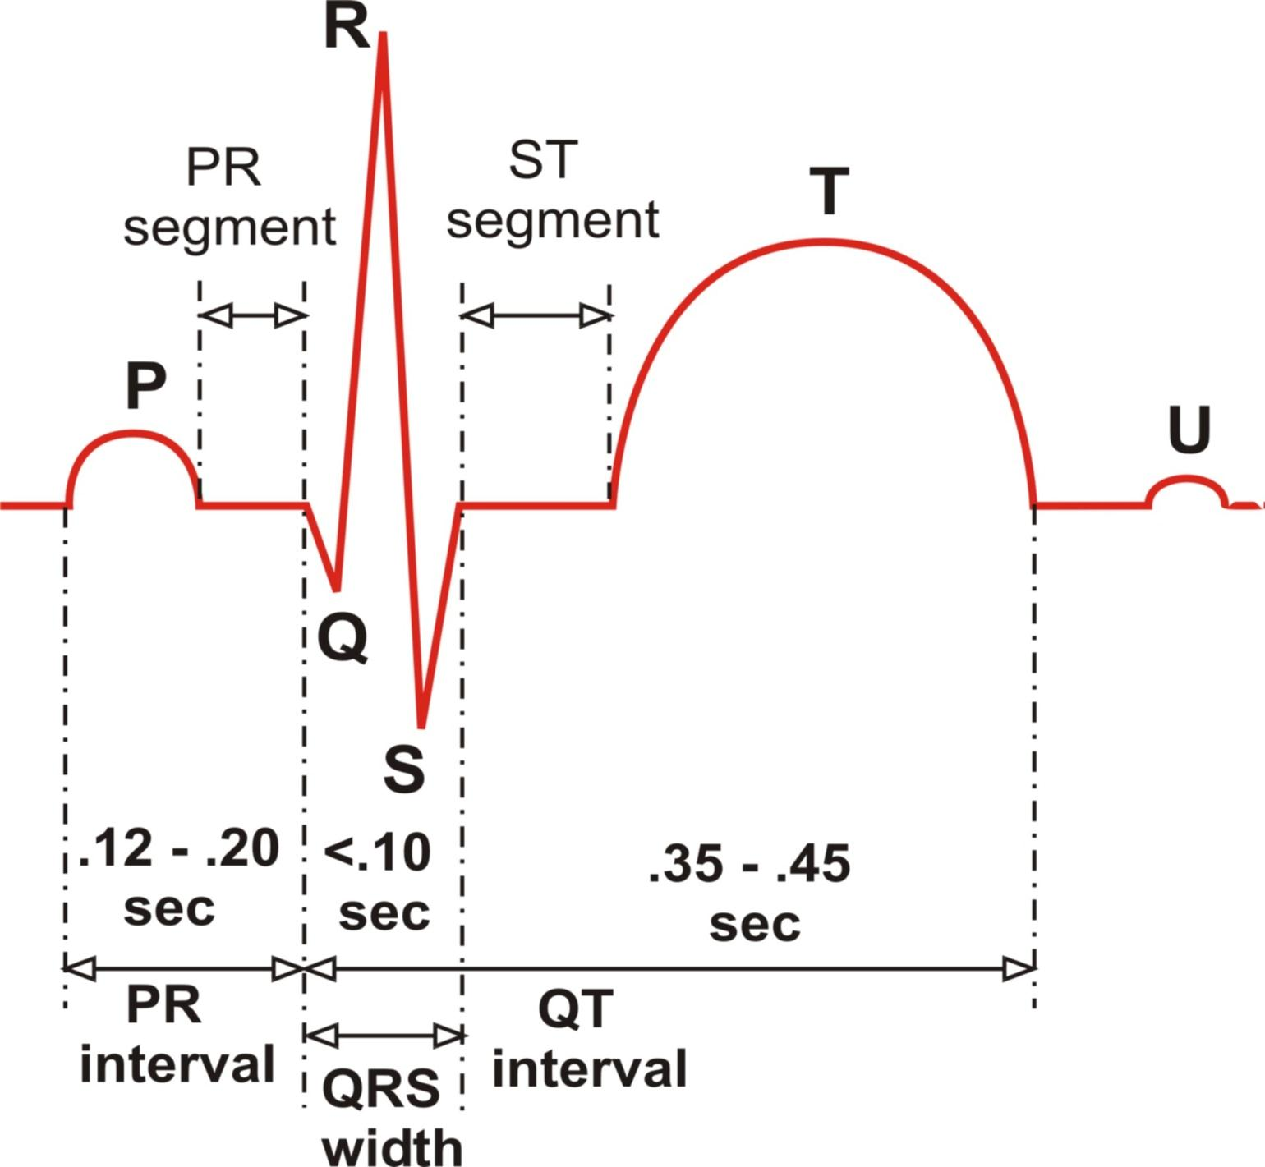
The ECG Complex with Interval and Segment Measurements

Slide 6
Remember This 3, 3, 3 and 5
P duration = 3 small sqs = 0.12 sec.
P height = 3 small sqs = 0.12 sec.
QRS duration = 3 small sq = 0.12 sec.
P-R interval = 5 small sqs = 0.2 sec.

Slide 7
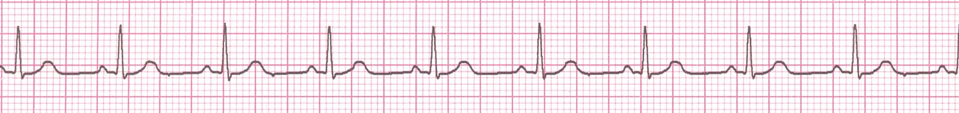
Rhythm Analysis
Step 1: Calculate rate.
Step 2: Determine regularity.
Step 3: Assess the P waves.
Step 4: Determine PR interval.
Step 5: Determine QRS duration.

Slide 8
Step 1: Calculate Rate
3 sec
3 sec
Option 1
Count the # of R waves in a 6 second rhythm strip, then multiply by 10.
Interpretation?
9 x 10 = 90 bpm

Slide 9
Step 1: Calculate Rate
300
150
100
75
60
50
Option 2 (cont)
Memorize the sequence:
300 - 150 - 100 - 75 - 60 - 50
Interpretation?
Approx. 1 box less than 100 = 95 bpm

Slide 10
Rate:
If regular : Divide 300/ number of large squares between 2 Rs = HR
If irregular: Count number of complexes in 6 sec. and multiply by 10
RATE may be: P = Sinus
Normal 60 -100 No P = Non sinus
Bradycardia < 60
Tachycardia > 100

Slide 11
Step 2: Determine regularity
R
R
Look at the R-R distances (using a caliper or markings on a pen or paper).
Interpretation?
Regular

Slide 12
Step 3: Assess the P waves
Are there P waves?
Do the P waves all look alike?
Do the P waves occur at a regular rate?
Is there one P wave before each QRS?
Interpretation?
Normal P waves with 1 P wave for every QRS

Slide 13
Step 4: Determine PR interval
Normal: 0.12 - 0.20 seconds.
(3 - 5 boxes)
Interpretation?
0.12 seconds

Slide 14
Step 5: QRS duration
Normal: 0.04 - 0.12 seconds.
(1 - 3 boxes)
Interpretation?
0.08 seconds

Slide 15
Rhythm Summary
Rate 90-95 bpm
Regularity regular
P waves normal
PR interval 0.12 s
QRS duration 0.08 s
Interpretation?
Normal Sinus Rhythm

Slide 16
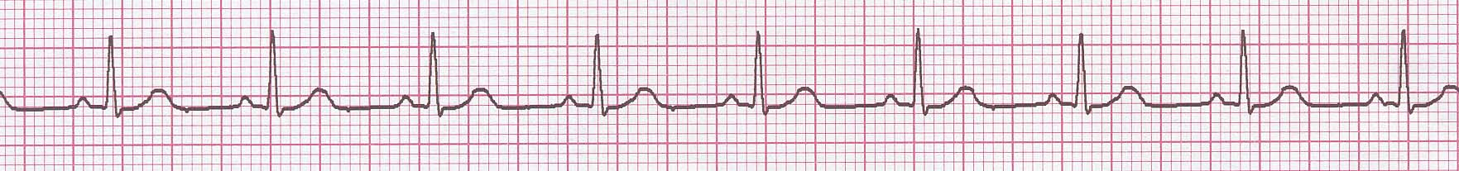
Normal Sinus Rhythm (NSR)
Etiology: the electrical impulse is formed in the SA node and conducted normally.
This is the normal rhythm of the heart; other rhythms that do not conduct via the typical pathway are called arrhythmias.

Slide 17
NSR Parameters
Rate 60 - 100 bpm
Regularity regular
P waves normal
PR interval 0.12 - 0.20 s
QRS duration 0.04 - 0.12 s
Any deviation from above is sinus tachycardia, sinus bradycardia or an arrhythmia

Slide 18
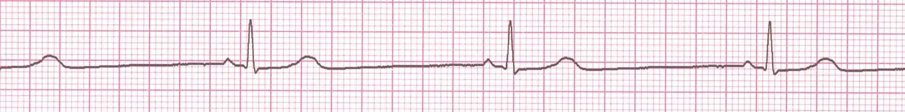
Rate?
30 bpm
Regularity?
regular
P waves?
normal
PR interval?
0.12 s
QRS duration?
0.10 s
Interpretation?
Sinus Bradycardia

Slide 19
Sinus Bradycardia
Deviation from NSR
- Rate < 60 bpm

Slide 20

Rate?
130 bpm
Regularity?
regular
P waves?
normal
PR interval?
0.16 s
QRS duration?
0.08 s
Interpretation?
Sinus Tachycardia

Slide 21
Sinus Tachycardia
Deviation from NSR
- Rate > 100 bpm

Slide 22
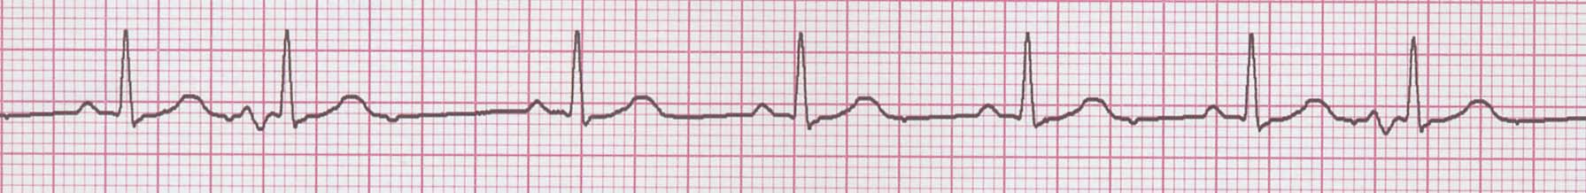
Rate?
70 bpm
Regularity?
occasionally irreg.
P waves?
2/7 different contour
PR interval?
0.14 s (except 2/7)
QRS duration?
0.08 s
Interpretation?
NSR with Premature Atrial Contractions

Slide 23
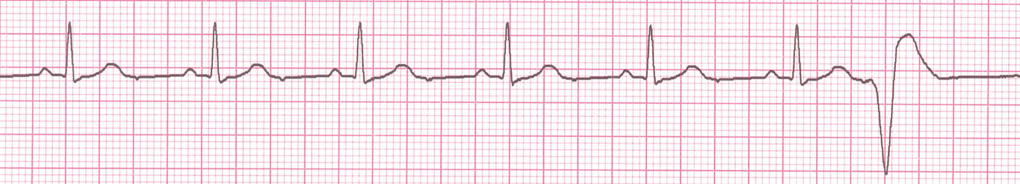
Rate?
60 bpm
Regularity?
occasionally irreg.
P waves?
none for 7th QRS
PR interval?
0.14 s
QRS duration?
0.08 s (7th wide)
Interpretation?
Sinus Rhythm with 1 PVC

Slide 24
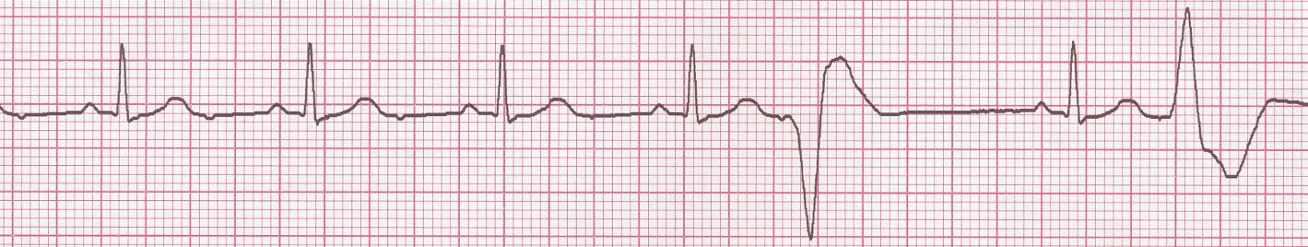
PVCs
Etiology: One or more ventricular cells are depolarizing and the impulses are abnormally conducting through the ventricles.

Slide 25
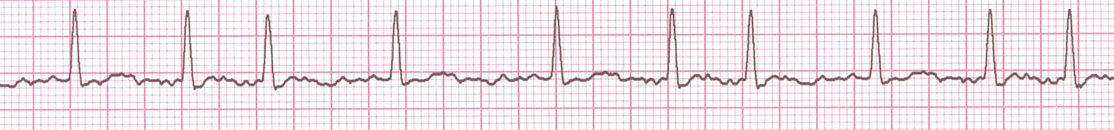
Rate?
100 bpm
Regularity?
irregularly irregular
P waves?
none
PR interval?
none
QRS duration?
0.06 s
Interpretation?
Atrial Fibrillation

Slide 26
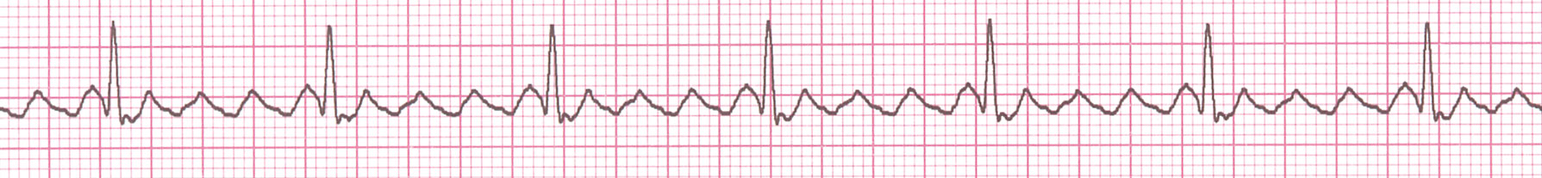
Rate?
70 bpm
Regularity?
regular
P waves?
flutter waves
PR interval?
none
QRS duration?
0.06 s
Interpretation?
Atrial Flutter

Slide 27
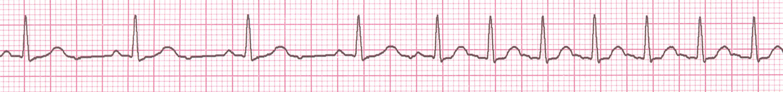
Rate?
74 →148 bpm
Regularity?
Regular → regular
P waves?
Normal → none
PR interval?
0.16 s → none
QRS duration?
0.08 s
Interpretation?
Paroxysmal Supraventricular Tachycardia (PSVT)

Slide 28
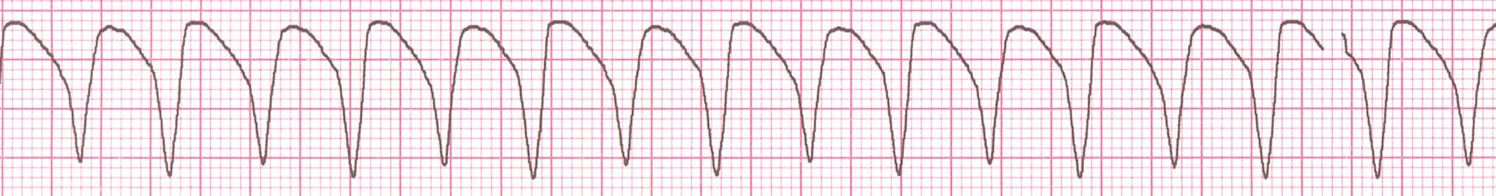
Rate?
160 bpm
Regularity?
regular
P waves?
none
PR interval?
none
QRS duration?
wide (> 0.12 sec)
Interpretation?
Ventricular Tachycardia

Slide 29
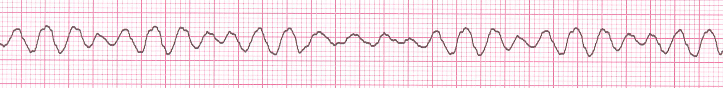
Rate?
none
Regularity?
irregularly irreg.
P waves?
none
PR interval?
none
QRS duration?
wide, if recognizable
Interpretation?
Ventricular Fibrillation

Slide 30
AV Nodal Blocks
1st Degree AV Block
2nd Degree AV Block, Type I
2nd Degree AV Block, Type II
3rd Degree AV Block

Slide 31
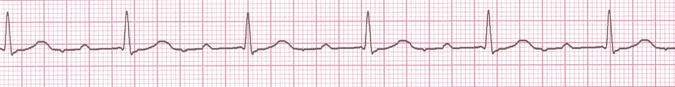
Rate? 60 BPM
Regularity? Regular
P waves? Normal
PR interval? 0.36 s
QRS duration? 0.08 s
Interpretation? 1st Degree AV Block

Slide 32
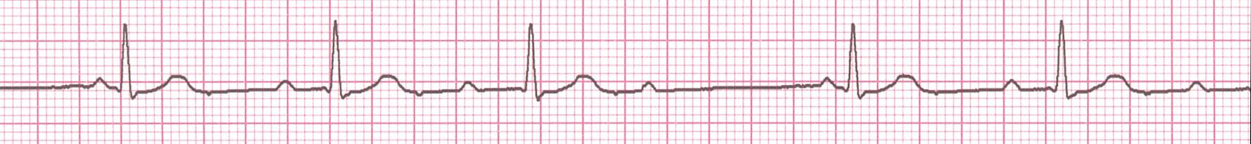
• Rate? 50 bpm
• Regularity? regularly irregular
P waves? nl, but 4th no QRS
• PR interval? Lengthens
QRS duration? 0.08 s
Interpretation? 2nd Degree AV Block, Type I
(Wenckebach, Mobitz type I)
PR interval progressively lengthens, then the impulse is completely blocked (P wave not followed by QRS)

Slide 33
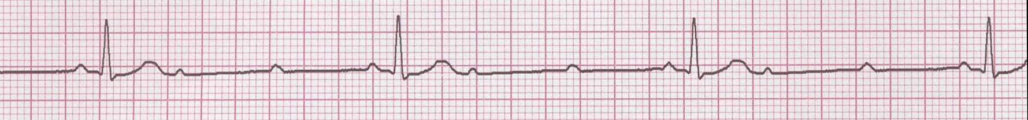
• Rate? 40 bpm
• Regularity? Regular
• P waves? nl, 2 of 3 no QRS
• PR interval? 0.14 s
• QRS duration? 0.08 s
Interpretation? 2nd Degree AV Block, Type II
Occasional P waves are completely blocked (P wave not followed by QRS).

Slide 34
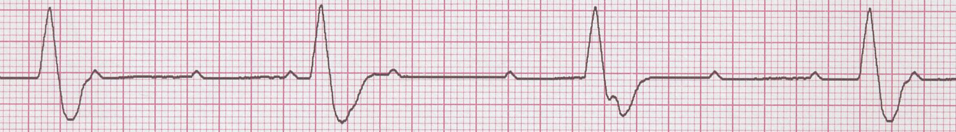
↑
↑
↑
↑
↑
↑
↑
↑
↑
• Rate? 40 bpm
• Regularity? regular
• P waves? no relation to QRS
• PR interval? None
• QRS duration? wide (> 0.12 s)
Interpretation? 3rd Degree AV Block

Slide 35
Left Bundle Branch Block (LBBB)
Diagnostic criteria for left bundle branch block
QRS duration of >0.12 s
Broad monophasic R wave in leads 1, V5, and V6
Absence of Q waves in leads V5 and V6

Slide 36
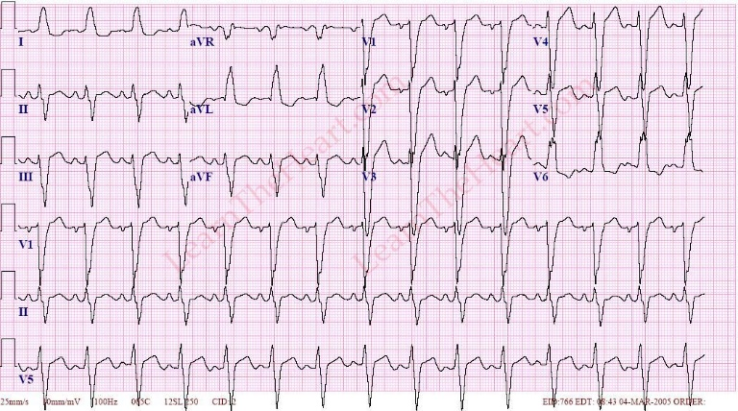
Left Bundle Branch Block (LBBB)

Slide 37
Right Bundle Branch Block (RBBB)
Diagnostic criteria for right bundle branch block
QRS duration >0.12 s
A secondary R wave (R') in V1 or V2
Wide slurred S wave in leads V5, and V6

Slide 38
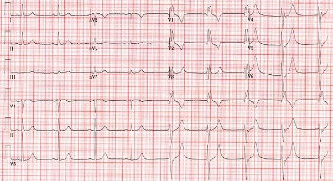
Right Bundle Branch Block (RBBB)

Slide 39
case
90 year old female k/c HTN presented to ER with dense Rt. side hemiplegia few hours duration.
Day before her presentation she was with her family doctor for F/u for her HTN and her pulse was regular and normal BP reading.
O/E : pt. is drawsy, BP : 80/40, P: 160 / min irregularly irregular
Rt. Side dense hemiplegia
CVS : s1 & S2 audible & irregular .
P/A and chest clear

Slide 40
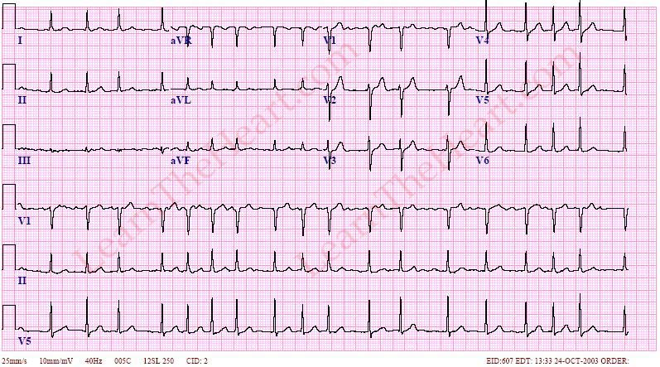
ECG

Slide 41
arrhythmia
Any disturbance in the normal sequence of impulse generation & conduction in the heart
Arrhythmias may occur with or without underlying heart disease.

Slide 42
Clinical presentation & symptomatology
Variable : from sever symptoms to asymptomatic .
Palpitation, angina, dyspnea & dizziness.
Mild hypotension …..Cardiogenic shock.
Mild dyspnea……….sever LVF.
No neurological findings……acute confusion.
Presentation with the preciptating disease.
Presentation with complications.

Slide 43
Eitiology
Structural heart diseases
IHD
Electrolytes disturbances
Thyroid function disorders
Hypoxia
Drugs
Circulatory abnormalities
Fever
Emotional
No clear causes

Slide 44
COMPLICATIONS
Hemodynamic complications.
Left ventricular failure & respiratory failure.
Arrhythmia assosciated CMP.
Embolisation phenomena.
Therapy related complications.

Slide 45
Diagnosis
History and examination
ECG & ECG monitoring
Echocardiography & TEE
Holter
Electrophysiological study
Investigations related to the assosciating diseases(eg. TFT, electrolytes, CXR…..

Slide 46
Tachycardia
QRS duration
R-R Interval
P waves analysis

Slide 47
TACHYCARDIA
VT
SVT with abberancy
or BBB
Wide
QRS
Narrow
Regular R-R
P waves
Irregular R-R interval
Absent or
Retrograde
Uniformly abnormal
Sawtooth ±
multiplicity
Absent Pwaves
Sawtooth
P waves
Multiformed
P waves
Atrial flutter
with constant
conduction
Atrial flutter
with variabl
conduction
SVT
Atrial fibrillation
MAT

Slide 48
TACHYCARDIA
QRS
Narrow
Irregular R-R interval
Absent Pwaves
Atrial fibrillation

Slide 50
Irregular
Atrial fibrillation
<48 hrs
Heparin
Electrical - 'DC cardioversion'
Pharmacology:
Amiodarone if structural heart disease,
Flecainide in those without structural heart disease or IHD.

Slide 51
_{Onset > 48 hours:}
_{Anticaogulate for 3 weeks.}
Transoesophageal echo (TOE) to exclude a left atrial appendage (LAA) thrombus.
Following electrical cardioversion patients should be anticoagulated for at least 4 weeks.

Slide 52
If the patient is haemodynamically compromised due to AF whatever the cause
>>> the emergency ttt is DC cardioversion: 200 J ⇒ 360 J ⇒ 360 J.

Slide 53
TACHYCARDIA
QRS
Narrow
Irregular R-R interval
Absent Pwaves
Multiformed
P waves
Atrial fibrillation
MAT

Slide 54
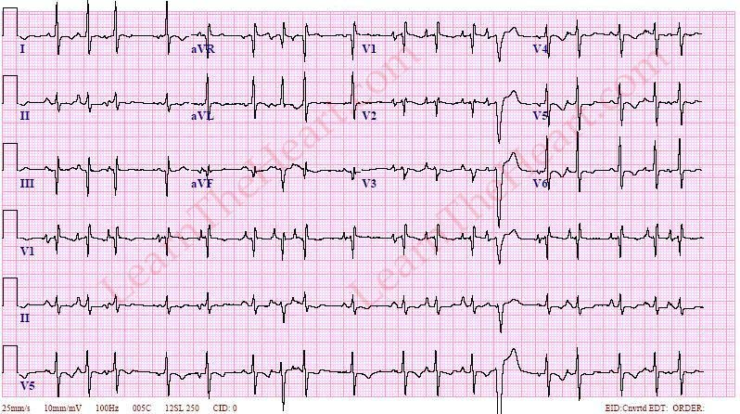

Slide 55
TACHYCARDIA
QRS
Narrow
Irregular R-R interval
Absent Pwaves
Sawtooth
P waves
Multiformed
P waves
Atrial flutter
with variabl
conduction
Atrial fibrillation
MAT

Slide 56
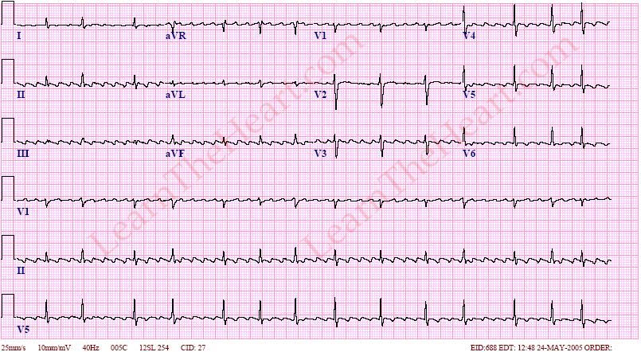

Slide 57
MAT
Correction of hypoxia and electrolyte disturbances.
Rate-limiting CCBs are often used first-line (Verapamil).
Cardioversion and digoxin are not useful in the management of MAT.
Atrial flutter with variable A:V conduction
It is similar to that of atrial fibrillation although medication may be less effective.
Atrial flutter is more sensitive to cardioversion however so lower energy levels may be used.

Slide 58
TACHYCARDIA
QRS
Narrow
Regular R-R
P waves
Irregular R-R interval
Absent or
Retrograde or
Uniformly abnormal
Absent Pwaves
Sawtooth
P waves
Multiformed
P waves
Atrial flutter
with variabl
conduction
Atrial fibrillation
MAT
SVT

Slide 59
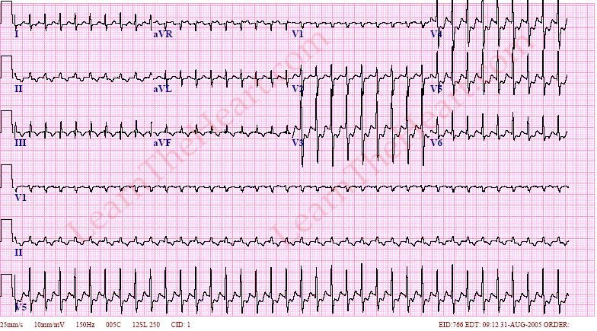

Slide 60
TACHYCARDIA
QRS
Narrow
Regular R-R
P waves
Irregular R-R interval
Absent or
Retrograde
Uniformly abnormal
Sawtooth ±
multiplicity
Absent Pwaves
Sawtooth
P waves
Multiformed
P waves
Atrial flutter
with constant
conduction
Atrial flutter
with variabl
conduction
Atrial fibrillation
MAT
SVT

Slide 61
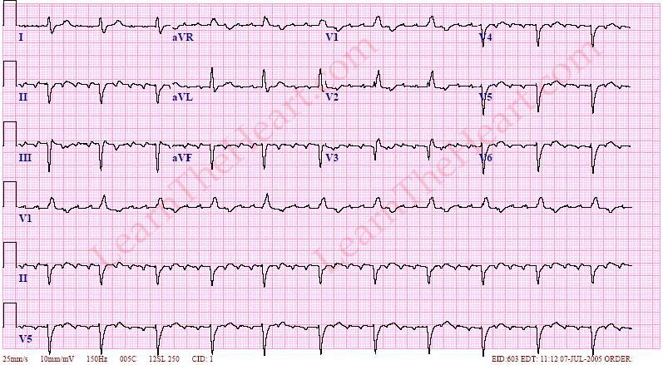

Slide 62
Regular
SVT
1) Vagal manoeuvres: it is the 1st line ttt in stable patient e.g. Carotid sinus massage, Valsalva manoeuvre, ice swallowing.
2) Adenosine IV: 6mg → 12mg → 12mg (total 30 mg IV).
3) DC-cardioversion with very low energy (50-100 J), the patient should be sedated before cardioversion.
Adenosine is contraindicated in asthmatics >> so, verapamil IV or flecainide IV is a preferable option
Atrial flutter with stable A:V conduction

Slide 63
TACHYCARDIA
VT
Wide
Supra ventricular
tachyarrhythmias
with abberancy or BBB
QRS
Narrow
Regular R-R
P waves
Irregular R-R interval
Absent or
Retrograde
Uniformly abnormal
Sawtooth ±
multiplicity
Absent Pwaves
Sawtooth
P waves
Multiformed
P waves
Atrial flutter
with constant
conduction
Atrial flutter
with variabl
conduction
Atrial fibrillation
MAT
SVT

Slide 64
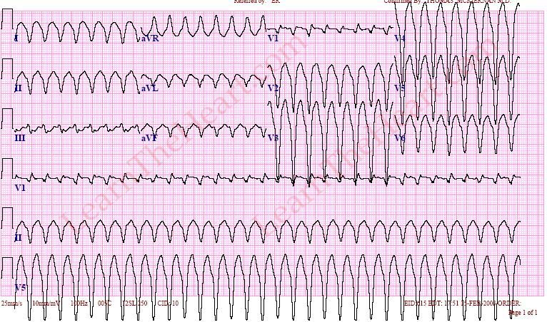

Slide 65
Wide complex Tachycardia
Regular:
Assume ventricular tachycardia VT (unless previously confirmed SVT with bundle branch block) >>> loading dose of amiodarone followed by 24 hour infusion (Dextrose) 5mg / kg over 1hour followed by 15mg/kg over 23 hours.
If haemodynamically unstable >>>>> DC shock

Slide 66
Irregular:
AF with bundle branch block - treat as for narrow complex tachycardia

Slide 67
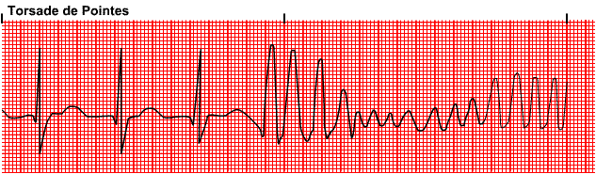
Polymorphic VT (e.g. Torsade de pointes) - IV magnesium

Slide 68
Bradycardia and Conduction Blocks

Slide 69
Sinus bradycardia
Sick sinus symdrome
Atrioventricular blocks
First degree AV block
Second degree AV block
Third degree AV block

Slide 70
Sinus Bradycardia
ECG Features
Heart rate < 60
a P wave before each QRS complex
PR interval of at least 0.12s

Slide 71
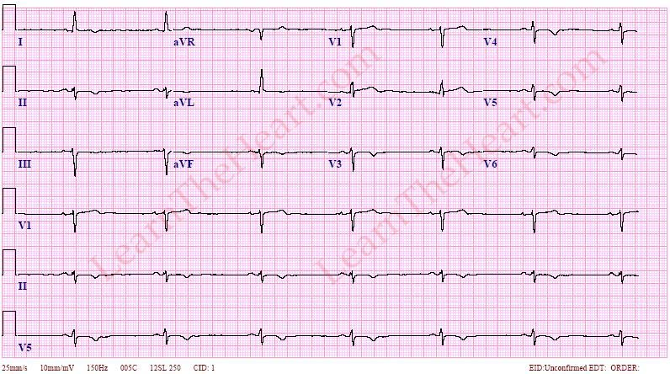
Sinus Bradycardia

Slide 72
Sinus Bradycardia
Normal physiological finding
Athletes
Young health individuals
Pathological
Acute MI(particularly inferior MI)
Drugs: beta-blockers, digoxin, amiodarone
Hypothyroidism
Hypothermia
Raised intracranial pressure
Obstructive jaundice
Sick sinus syndrome

Slide 73
Sick Sinus Syndrome
Dysfunction of sinoatrial node
ECG features:
Persistent and often severe sinus bradycardia
Periods of
sinoatrial block
sinus arrest
junctional or ventricular escape rhythms
Tachycardia ­bradycardia syndrome
paroxysmal atrial flutter
atrial fibrillation

Slide 74
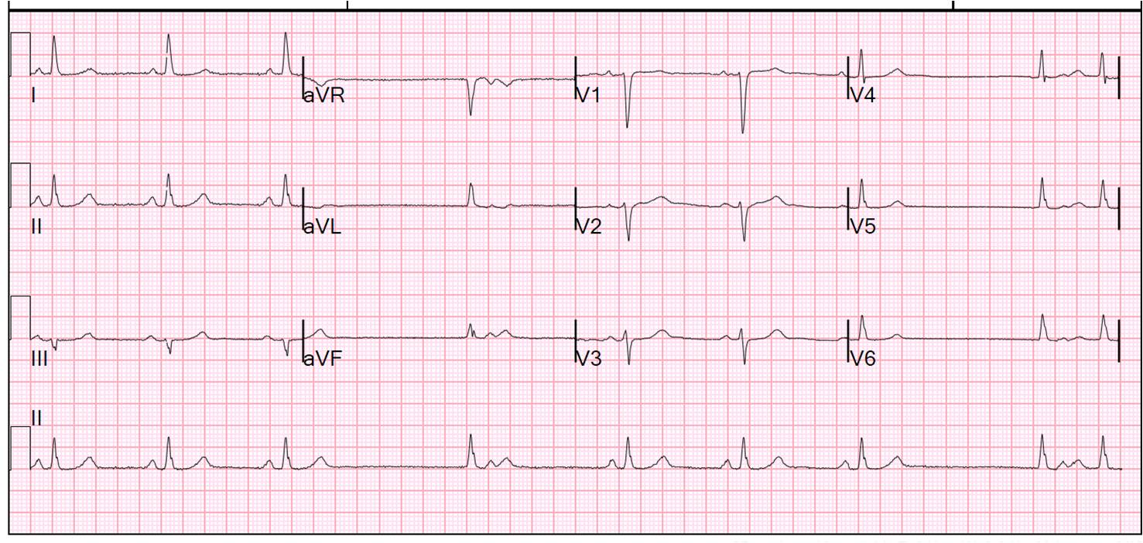
Sick Sinus Syndrome

Slide 75
Sick Sinus Syndrome
Conditions associated with sinoatrial node dysfunction
Age
Idiopathic fibrosis
Ischaemia, including myocardial infarction
High vagal tone
Myocarditis
Digoxin toxicity

Slide 76
Atrioventricular conduction block
First degree AV block: delayed conduction
Second degree AV block: intermittent conduction
Third degree AV block: complete block

Slide 77
First degree AV block
ECG features
Prolongation of the PR interval to > 0.2 s
PR interval remains constant.
QRS complex follows each P wave

Slide 78
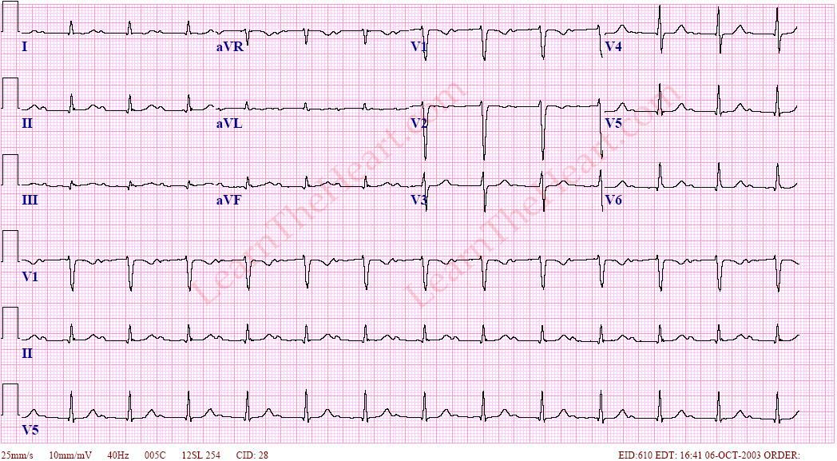
First degree AV block

Slide 79
Second degree AV block
Mobitz type I block (Wenckebach phenomenon)
usually at the level of the AV node, producing intermittent failure of transmission of the atrial impulse to the ventricles.

Slide 80
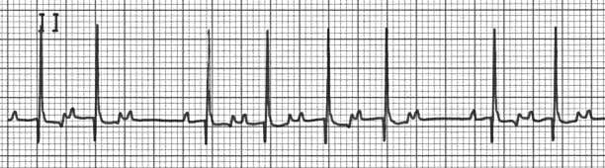
Second degree AV block

Slide 81
Second degree AV block
Mobitz type II block
less common but is more likely to produce symptoms

Slide 82
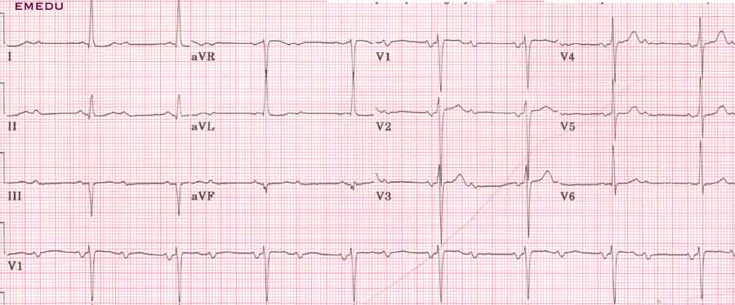
Second degree AV block

Slide 83
Third degree AV block
complete failure of conduction between the atria and ventricles, with complete independence of atrial and ventricular contractions.
The P waves has no relation to the QRS complexes and usually proceed at a faster rate.

Slide 84
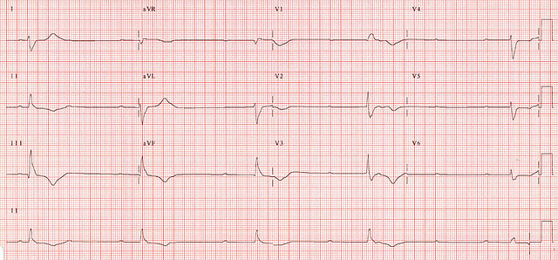

Slide 85


