Slide 1


Childhood Obesity
Obesity
ST. Name: Yasmin Alferjani
ST.NO: 3368
Year 1 block GBMS 2
Supervisor: Dr Fatma Elsaity
Date: 1/6/2022
2021-2022
1

Slide 2
Objectives
01
02
03
04
05
Introduction
Outline the Etiology of Obesity
List Physical complications of Obesity
List Psychological difficulties of Obesity
Discuss ways of Diagnosing Obesity
2

Slide 3
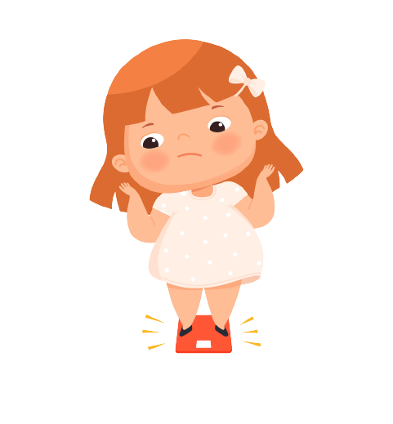
Introduction
Obesity is a complex disease involving an excessive amount of body fat.
Obesity isn't just a cosmetic concern. It's a medical problem that increases the risk of other diseases and health problems. ⁽¹⁾
3

Slide 4

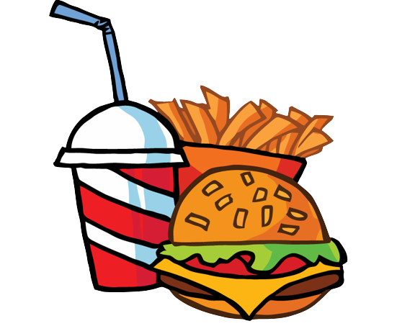
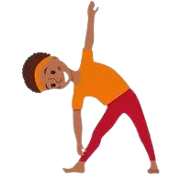

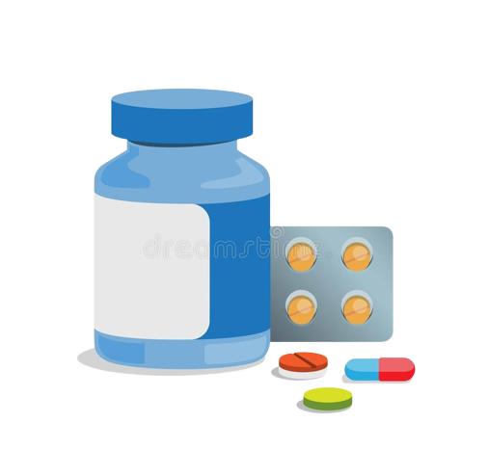
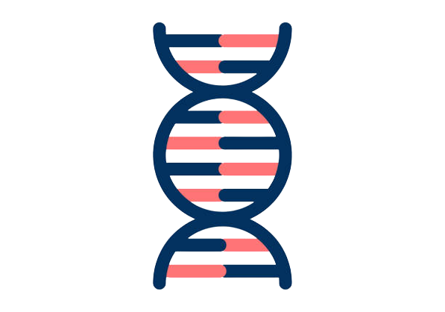
Outline the Etiology of Obesity
Causes of Obesity:
Eating patterns, Physical activity levels, Sleep routines .
Social Determinants of Health (SDOH).
Genetics.
Illnesses and Medications. ⁽⁴⁾
4
Notes:
Many factors can contribute to excess weight gain including:
It can be difficult to make healthy food choices and get enough physical activity if these conditions don’t support health

Slide 5
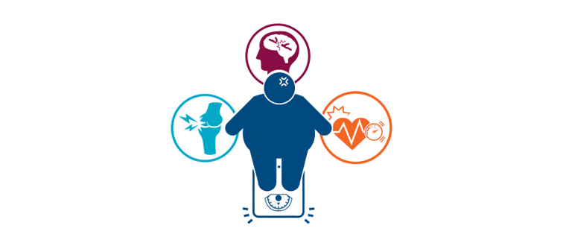

List Physical complications of Obesity
Childhood unhealthy weights may result in serious medical problems in childhood such as:
Type 2 diabetes.
High blood pressure and elevated blood cholesterol.
Liver disease.
Bone and joint problems.
Respiratory problems such as asthma. ⁽⁵⁾

Slide 6
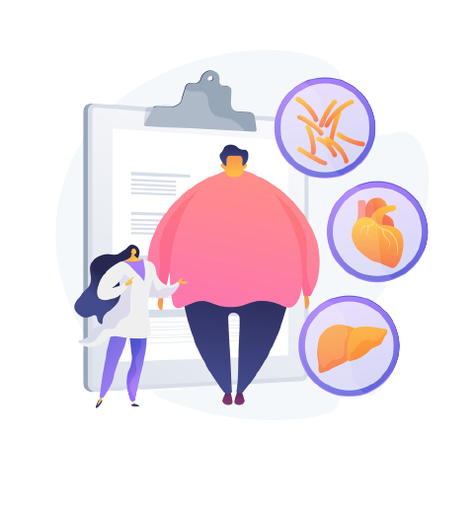
List Physical complications of Obesity
Sleep disorders such as difficulty breathing while asleep (sleep apnea).
Earlier than normal puberty or menstruation.
Eating disorders such as anorexia or bulimia.
Skin infections due to moisture from sweat being trapped in skin folds.
Fatigue. ⁽⁵⁾
6

Slide 7
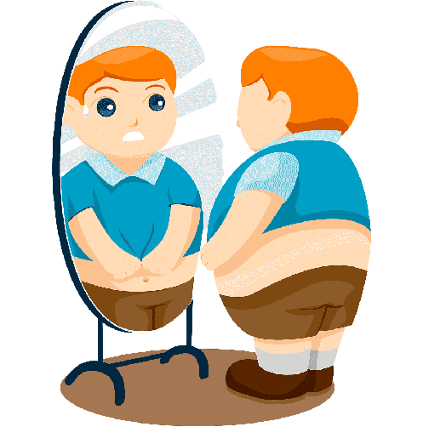
List Psychological difficulties of Obesity
Overweight or obese children:
Are more likely to be teased and bullied.
Are more likely to bully others.
May have poor self-esteem and may feel socially isolated. ⁽⁵⁾
7

Slide 8
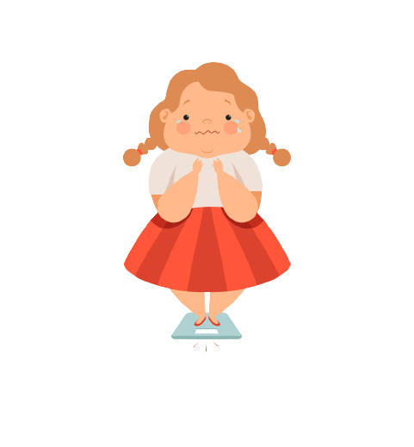
List Psychological difficulties of Obesity
May be at increased risk for depression.
May have poorer social skills.
May have high stress and anxiety.
May have behavior and/or learning problems as a result of psychological difficulties related to childhood obesity. ⁽⁵⁾
8

Slide 9


Discuss ways of Diagnosing Obesity
Keep in mind:
Not all children carrying extra pounds are overweight.
Some children have larger than average body frames.
Children normally carry different amounts of body fat at various stages of development.
So a child’s physical appearance isn’t always a health concern, even if they might seem overweight. ⁽²⁾
9

Slide 10
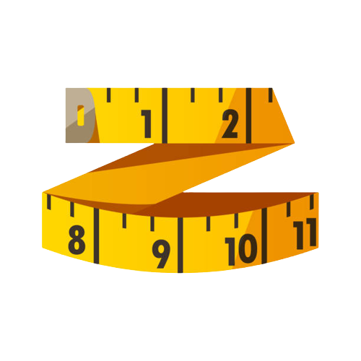
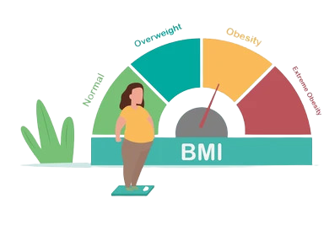
Discuss ways of Diagnosing Obesity
Most popular methods for measuring body fat:
Body Mass Index (BMI).
Waist Circumference.
Waist-to-Hip Ratio.
Skinfold Thickness. ⁽³⁾
10

Slide 11
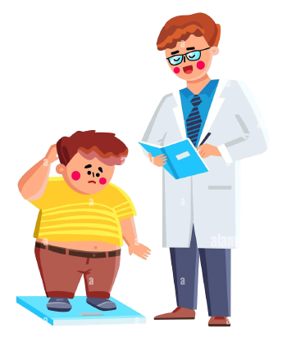
Conclusion
Obesity is not taken as seriously as it should be, which is resulting in continuous growth in the number of people suffering from the condition.
Health professionals should be trained to talk about weight loss in a more supportive way.
11

Slide 12
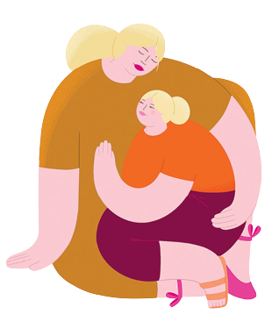
Conclusion
Many people don’t think of obesity as a disease, but rather as a moral failing. Obesity is not a choice and making people feel ashamed results only in them feeling worse about themselves.
Stigma, blame, and shame add to the problem, and are obstacles to treatment.
12

Slide 13
References
1. Obesity - Symptoms and causes [Internet]. Mayo Clinic. 2022 [cited 11 May 2022]. Available from: https://www.mayoclinic.org/diseases-conditions/obesity/symptoms-causes/syc-20375742#:~:text=Overview,blood%20pressure%20and%20certain%20cancers.AUTHOR (YEAR). Title of the publication. Publisher
2. Childhood obesity - Symptoms and causes [Internet]. Mayo Clinic. 2022 [cited 11 May 2022]. Available from: https://www.mayoclinic.org/diseases-conditions/childhood-obesity/symptoms-causes/syc-20354827AUTHOR (YEAR). Title of the publication. Publisher
3. Measuring Obesity [Internet]. Obesity Prevention Source. 2022 [cited 11 May 2022]. Available from: https://www.hsph.harvard.edu/obesity-prevention-source/obesity-definition/how-to-measure-body-fatness/
4. [Internet]. 2022 [cited 11 May 2022]. Available from: https://www.cdc.gov/obesity/basics/causes.html
5. What Are The Complications of Childhood Obesity? - Childhood Obesity Foundation [Internet]. Childhood Obesity Foundation. 2022 [cited 11 May 2022]. Available from: https://childhoodobesityfoundation.ca/what-is-childhood-obesity/complications-childhood-obesity/
13

Slide 14
Thanks!
14

