Slide 1


The Principles of Power and Influence
The Libyan International Medical University
The Faculty Of Business
Student Name :Rabeia Elmansoury
Student number: 3483
Rabeia_3483@limu.edu.ly

Slide 2
Table of Contents
02.
Introduction.
01.
Intended learning outcomes .
03.
The Principles of Power and Influence.
04.
Conclusion .
05.
Reflection.
06.
References.
2

Slide 3
Intended learning outcomes
In the end of this presentation you would be able to :
01 Recognize the Differences between Power and Influence.
02 List the Principles of Power and Influence.
03 Differentiate between the Principles of Power and Influence.
3

Slide 4
Introduction
Power "the authority to affect the behavior of others and force them to do things they would not do otherwise .
Influence "the ability to change other people's perspectives of a situation .“
it.
4

Slide 5
Principles of Power and Influence
5

Slide 6
Some people are more powerful than others
All people are treated equally under the law, and therefore have equal access to education, legal protection, and freedom of speech. However, when it comes to almost everything else, everyone is not equal.
Some people are born physically strong, attractive, and healthy, whereas others are born weak, unattractive, and with a range of genetic disorders .
Power is asymmetrical: if one person has more, the other must have less. If you are stronger than someone else, that person is weaker than you.
6

Slide 7
Power can be shared
Some people would argue that power should be guarded that by sharing it with others, you dilute your own power.
Another position would argue that by sharing your power, by empowering others, you actually grow in power.
You could empower others by:
Raise the person’s self-esteem
Be open, positive, empathic, and supportive
Share skills and decision making
7

Slide 8
Power can be increased or decreased
Although humans differ greatly in the amount of power they control .Everyone has the ability to expand their power in some way. You can improve your physical strength by lifting weights.. You can improve your persuasive ability by learning communication principles.
Power can also be decreased. Probably the most common way to lose power is
by trying to control another’s behavior unsuccessfully. A way to lose power is to allow others to control you.
8

Slide 9
Power follows the principle of less interest
In any interpersonal relationship, the one in power is the one who is less interested in and less dependent on the other person's rewards and punishments . The more an individual needs a relationship, the less authority he or she has over it. The less a person needs a relationship, the more powerful that person is.
9

Slide 10
Power generates privilege
When one person has authority over another, it is commonly considered that the person in power has certain privileges, many of which include communication privileges .
And the greater the difference in power, the greater the license of the more powerful individual. We are sometimes aware of the privilege or license that comes with authority. Most of the time, though, we appear to be operating mindlessly, with no one challenging the power structure.
10

Slide 11
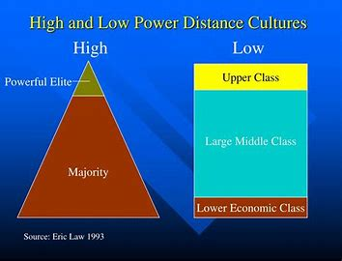
Power has a cultural dimension
Cultures differ in the amount of power distance which is the way people in the society relate on a hierarchical scale.A culture that gives great deference to a person of authority is a high power distance culture ,and a culture that values the equal treatment of everyone is a low power distance culture.
11

Slide 12
Conclusion
Influence helps people realize why a task is vital, whereas power pushes them to execute . And recognize the six principles of power and influence could help in maintaining them in the work place which are ‘’some people are more powerful than others, Power can be shared, Power can be increased or decreased. Power follows the principle of less interest, Power generates privilege , Power has a cultural dimension.
12

Slide 13
Reflection
In my opinion understanding the difference between power and influence helps a lot in doing the work perfectly on time.
I think in Libya there is a huge misunderstanding of influence because they mix it the privileges that they had from power and also because of the differences in the hierarchical scale that we have got from being a high power distance culture .
13

Slide 14
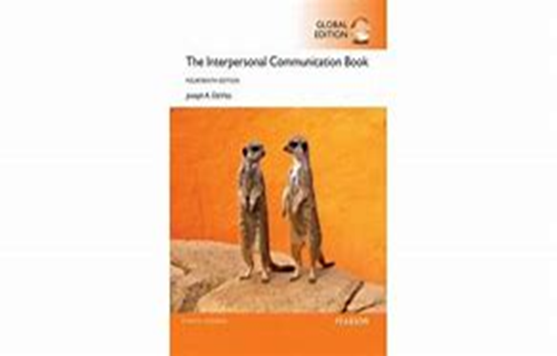
References
Joseph A. DeVito (2016). The interpersonal
communication book 14th edition .
14

Slide 15
Thank you
Any questions?

