Slide 1


Differences Between Normative and Descriptive Concepts of Political Science
Libyan International Medical University Faculty Of Business Administration
Name: Nahawand elhammali
ID:2752
Email: nahawand_2752@limu.edu.ly

Slide 2
Table Of Contact:
01.
Definition
Normative And Descriptive
Concepts
02.
Dimensions of
Normative And Descriptive
03.
Differences Between Normative And Descriptive
Concepts
04.
Examples About Normative And Descriptive

Slide 3
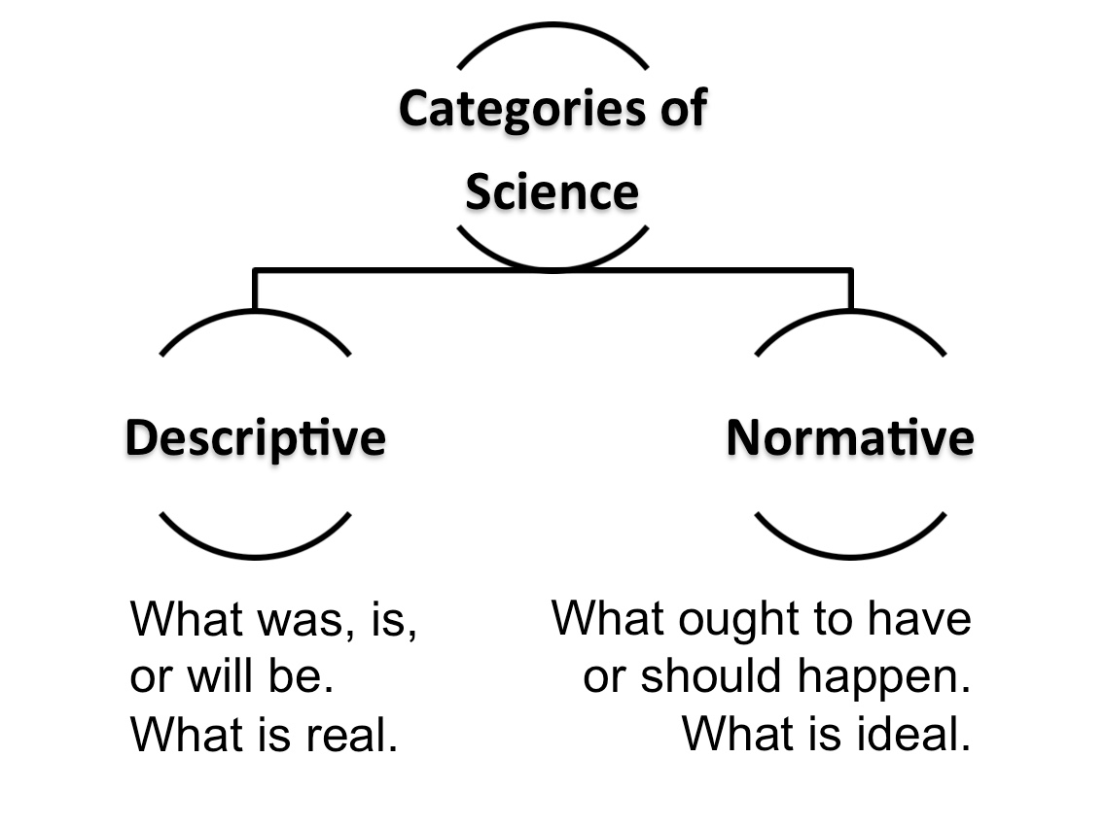
Introduction:
Introduction:
Normative ethics is the study of ethical action, analyses how people ought to act . Whereas descriptive ethics is the study of people's ideas on moral convictions ,and analyses what people think is right.

Slide 4

Definition:
Normative Ethics:
Normative ethics is the study of ethical behavior ,and that normative ethics examines how individuals should act.
Descriptive Ethics:
Descriptive ethics is the study of people's attitudes about moral convictions ,and descriptive ethics examines what people believe is correct.

Slide 5
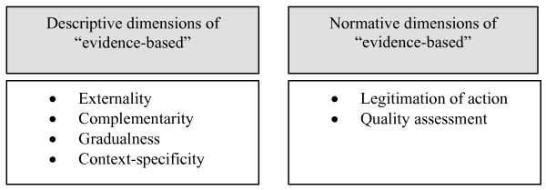
Normative And Descriptive Dimensions of the Concept:
Descriptive Dimensions
Normative Dimensions

Slide 6
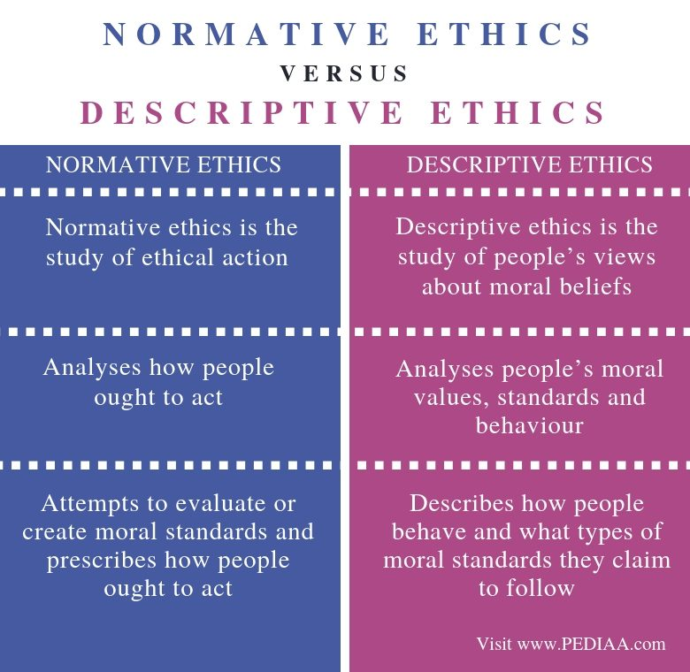
Differences:

Slide 7
Examples:-
Normative Concept:
The golden rule is a classic example of a normative principle: we should do to others what we would want others to do to us. Since I do not want my neighbor to steal my car, then it is wrong for me to steal her car.
Descriptive Concept:
An example of descriptive is someone giving a very detailed account of an experience they had.

Slide 8
Conclusion:
Normative ethics is the study of ethical action. Whereas the study of people's ideas on moral convictions is known as descriptive ethics.

Slide 9
References:
Anon https://iep.utm.edu/ethics/, accessed 26 October 2021.
Anon Descriptive ethics [Internet]. http://www.artandpopularculture.com/Descriptive_ethics, accessed 26 October 2021.
Hasa (2019) Difference between normative ethics and Descriptive Ethics [Internet]. https://pediaa.com/difference-between-normative-ethics-and-descriptive-ethics/amp/, accessed 26 October 2021.

Slide 10
Thank you
Any question !

