Slide 1


The Difference between Parametric and Non-parametric Statistics
Libyan International Medical University
Faculty of business administration
Name: Rana Albrakey
Student ID: 3826

Slide 2
Table of contents
Objectives
Introduction
How to select a sample from a population?
Difference between parametric and non-parametric statistcs.
Conclusion
References

Slide 3
Objectives
Describe how to determine a sample
Describe the difference between parametric and non-parametric statistics

Slide 4
Introduction
Sampling is the process of selecting a group of individuals from a population to study them and characterize the population as a whole.

Slide 5
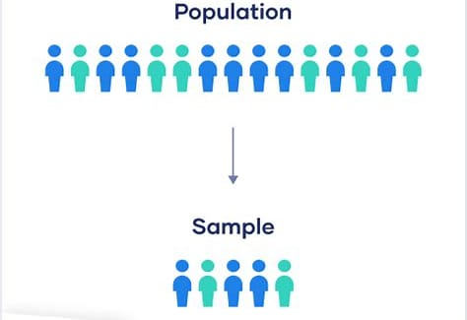

Slide 6
How to select a sample from a population?
Probability sampling
Non-probability sampling

Slide 7




Probability sampling
Simple random sample.
Systematic random sample.
Stratified sampling.
Cluster sampling.

Slide 8


Non-probability sampling
Convenience sampling.
Voluntary response sampling.

Slide 9
Difference between parametric and non-parametric statistics
Parametric :
Non-parametric :
Interval or ratio scale data
Normally distributed
No outliers
Equal variances
Large sample
Nominal or ordinal data
Not normal
outliers
Unequal variances
Small sample

Slide 10
Conclusion
By doing statistics on the sample when drawing random and representative samples from population we could make valid generalizations or inferences to the population.

Slide 11
References
McCombes, S. (2022, January 19). An introduction to sampling methods. Scribbr. Retrieved May 11, 2022, from https://www.scribbr.com/methodology/sampling-methods/
Parametric statistic. Parametric Statistic - an overview | ScienceDirect Topics. (n.d.). Retrieved May 11, 2022, from https://www.sciencedirect.com/topics/computer-science/parametric-statistic

Slide 12
THANK YOU

