Slide 1
Sclera AND Episclera
By Assistant Prof Hammad Eljazwi,MD

Slide 2
Table of contents
1
2
3
4
ANATOMY
EPISCLERITIS
SCLERAL DISCOLORATION
Immune mediated SCLERITIS

Slide 3
01
Anatomy

Slide 4
Anatomy
- The scleral stroma is composed of collagen bundles of varying size and shape that are not uniformly orientated as in the cornea, and so are not transparent.
- The inner layer of the sclera (lamina fusca) blends with the uveal tract. Anteriorly the episclera consists of a connective tissue layer between the superficial scleral stroma and Tenon capsule.
There are three pre-equatorial vascular layers:
• Conjunctival vessels are the most superficial
• Superficial episcleral plexus In episcleritis, maximal congestion occurs at this level , Topical phenylephrine 2.5% will also constrict the conjunctival and 10% also the superficial episcleral vessels.
• Deep vascular plexus lies in the superficial part of the sclera and shows maximal congestion in scleritis

Slide 5
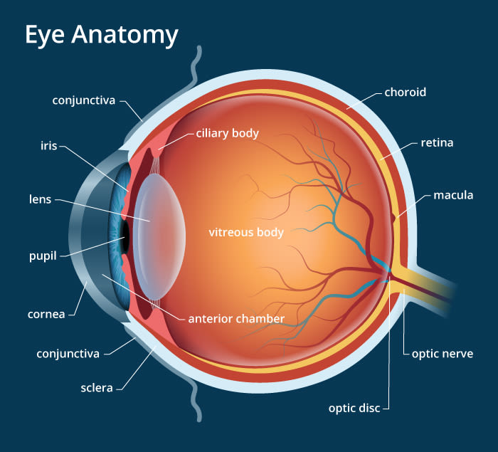
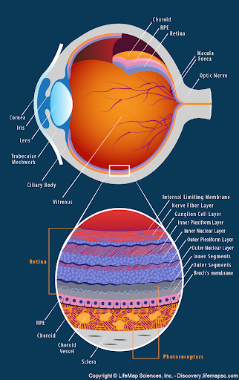
Anatomy

Slide 6
02
EPISCLERITIS

Slide 7
EPISCLERITIS
Episcleritis is a common, usually idiopathic and benign, recurrent and frequently bilateral condition.
Females may be affected more commonly than males
Associated disease,
ocular (e.g. dry eye, rosacea, contact lens wear)
systemic (e.g. collagen vascular disorders such as rheumatoid arthritis, herpes zoster ophthalmicus, gout and others)

Slide 8
Episcleritis
1
2
SIMPLE episcleritis
Nodular episcleritis
- Simple episcleritis accounts for 75% of cases.
- Symptoms. Redness; discomfort Grittiness, and photophobia.
- Visual acuity is almost always normal.
- Nodular episcleritis also tends to affect females but has a less acute onset and a more prolonged course.
red eye is typically first noted on waking
A tender red vascular nodule
Intraocular pressure (IOP) is very occasionally elevated

Slide 9
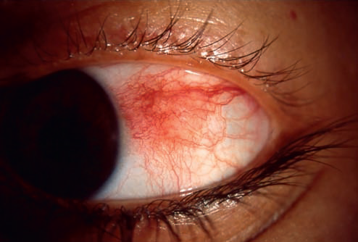
Episcleritis
Simple episcleritis
Nodular episcleritis

Slide 10
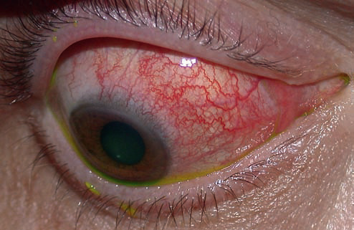
Episcleritis
Diffuse episcleritis

Slide 11
Treatment
If mild, no treatment is required; cool compresses or refrigerated artificial tears may be helpful
A weak topical steroid four times daily for 1–2 weeks
topical non-steroidal anti-inflammatory (NSAID) is an alternative, though may be less effective.
oral NSAID is occasionally required (e.g. ibuprofen 200 mg three times daily, or occasionally a more potentagent such as indometacin).

Slide 12
03
IMMUNE MEDIATED SCLERITIS

Slide 13
01
02
03
Anterior non-necrotizing scleritis
Anterior necrotizing scleritis
Posterior scleritis

Slide 14
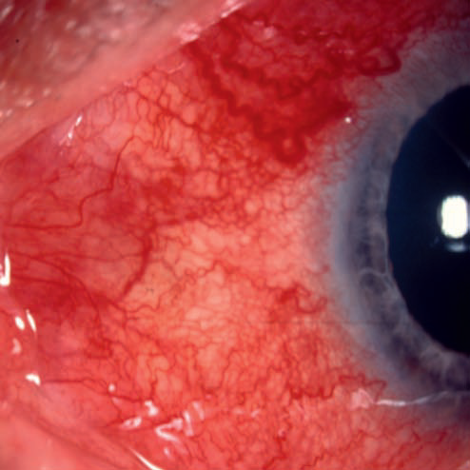
Anterior non-necrotizing scleritis
Diffuse non-necrotizing scleritis
Translucency dur to recurrence non-necrotizing scleritis

Slide 15
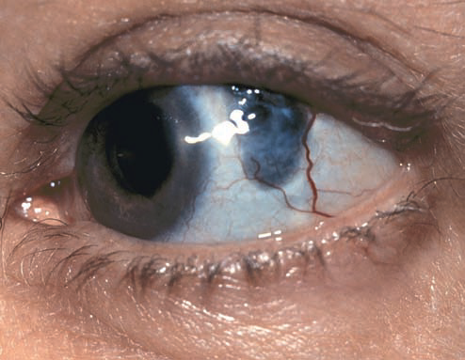
Anterior necrotizing scleritis
Early
late

Slide 16
Anterior necrotizing scleritis
Surgical induce necrotizing scleritis
PUK secondary to necrotizing scleritis

Slide 17
Complications
Acute infiltrative stromal keratitis
Peripheral ulcerative keratitis
Uveitis
Glaucoma
Hypotony may be the result of ciliary body detachment
Perforation extremely rare.

Slide 18
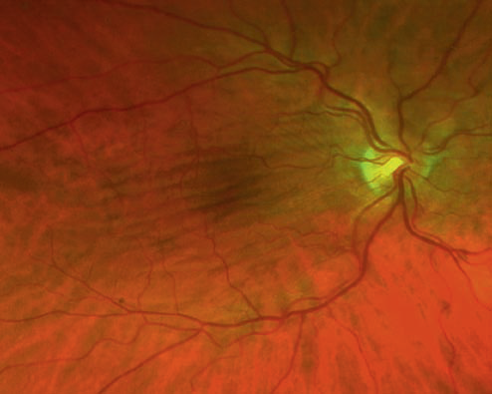
Posterior scleritis
Choroidal folds
B-scan ultrasonography in posterior scleritis shows scleral thickening

Slide 19
Investigation and Treatment
Laboratory (ESR), (CRP), full blood count, rheumatoid factor, (ANA), (ANCA), uric acid, syphilis serology, hepatitis B surface antigen ,Investigation for tuberculosis, sarcoidosis or ankylosing spondylitis.
Radiological imaging
Ultrasonography can help to detect associated posterior scleritis
Treatment
Topical steroid four times daily for 1–2 weeks
Systemic NSAIDs
Periocular steroid injections
Systemic steroids
immunosuppressives

Slide 20
Systemic association the immune mediated scleritis
1
2
3
4
Rheumatoid arthritis
Wegener granulomatosis
Relapsing polychondritis
Polyarteritis nodosa

Slide 21
04
SCLERAL DISCOLORATION

Slide 22
01
02
03
04
Alkaptonuria bluish-grey or black generalized pigmentation of the sclera
Haemochromatosis rusty-brown perilimbal conjunctival and scleral discoloration
BLUE SCLERA Blue scleral discoloration is caused by thinning or transparency with resultant visualization of the underlying uvea
Major associations
Osteogenesis imperfecta defects in the synthesis and structure of type 1 collagen
Ehlers–Danlos syndrome type VI
Congenital ocular melanocytosis

Slide 23
SCLERAL DISCOLORATION
Blue sclera
Alkaptourea

Slide 24
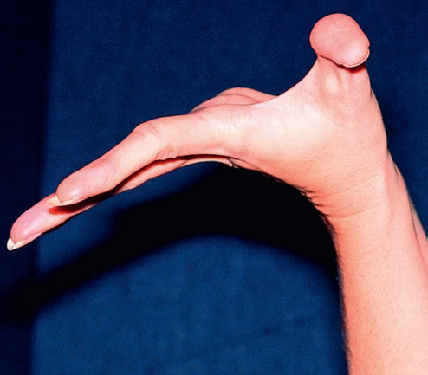
SCLERAL DISCOLORATION
Multiple fractures in osteogenesis imperfecta
cutaneous hyperelasticity Ehlers–Danlos syndrome VI
joint hypermobility in Ehlers–Danlos syndrome VI

Slide 25
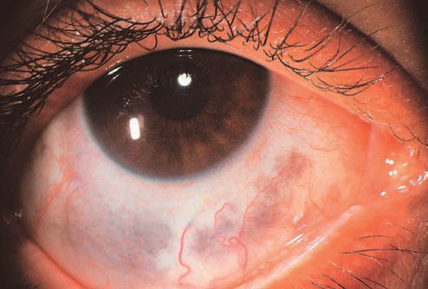
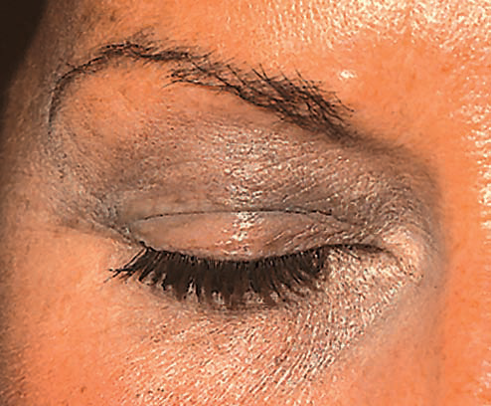
SCLERAL DISCOLORATION
Episcleral melanocytosis
cutaneous melanocytosis in naevus of Ota

Slide 26
– Pele
Thanks!
Success is no accident.
It is hard work, perseverance,
learning, studying, sacrifice and most of all, love of what you are doing or learning to do

